Slide 1
N.C. Strategic Transportation Corridors Master Plans
US 74
July 2018

Slide 2
Welcome and Introductions
North Carolina STC Master Plans
STC Master Plans Overview
Study Area Description
Public Outreach
Plan Deliverable
Next Steps

Slide 3
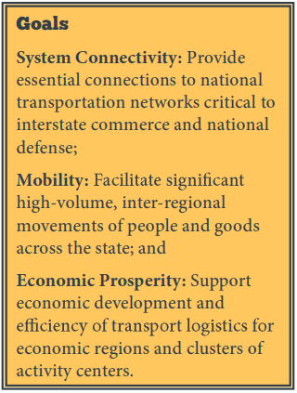
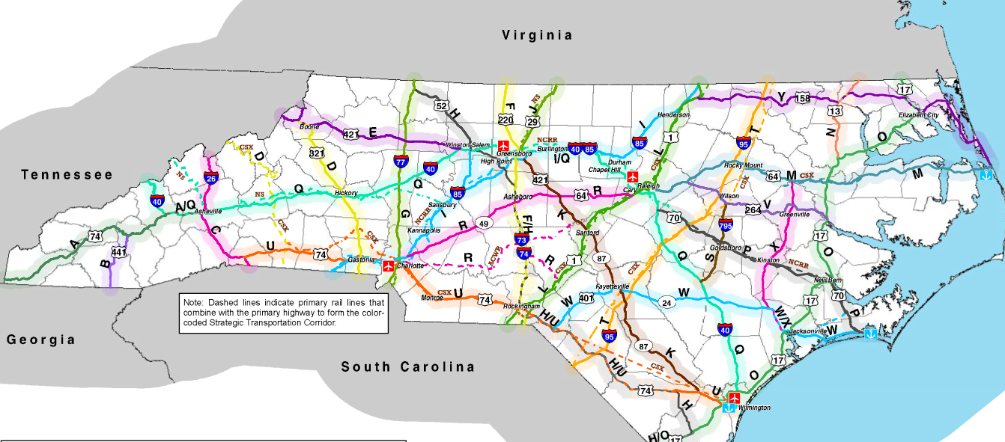
Strategic Transportation Corridors
North Carolina STC Master Plans

Slide 4
Strategic Highway Corridors vs. Strategic Transportation Corridors
North Carolina STC Master Plans
SHC | STC
Identified vision | Collaborative vision
55 corridors | 25 corridors
Vehicle-focused | Multimodal

Slide 5
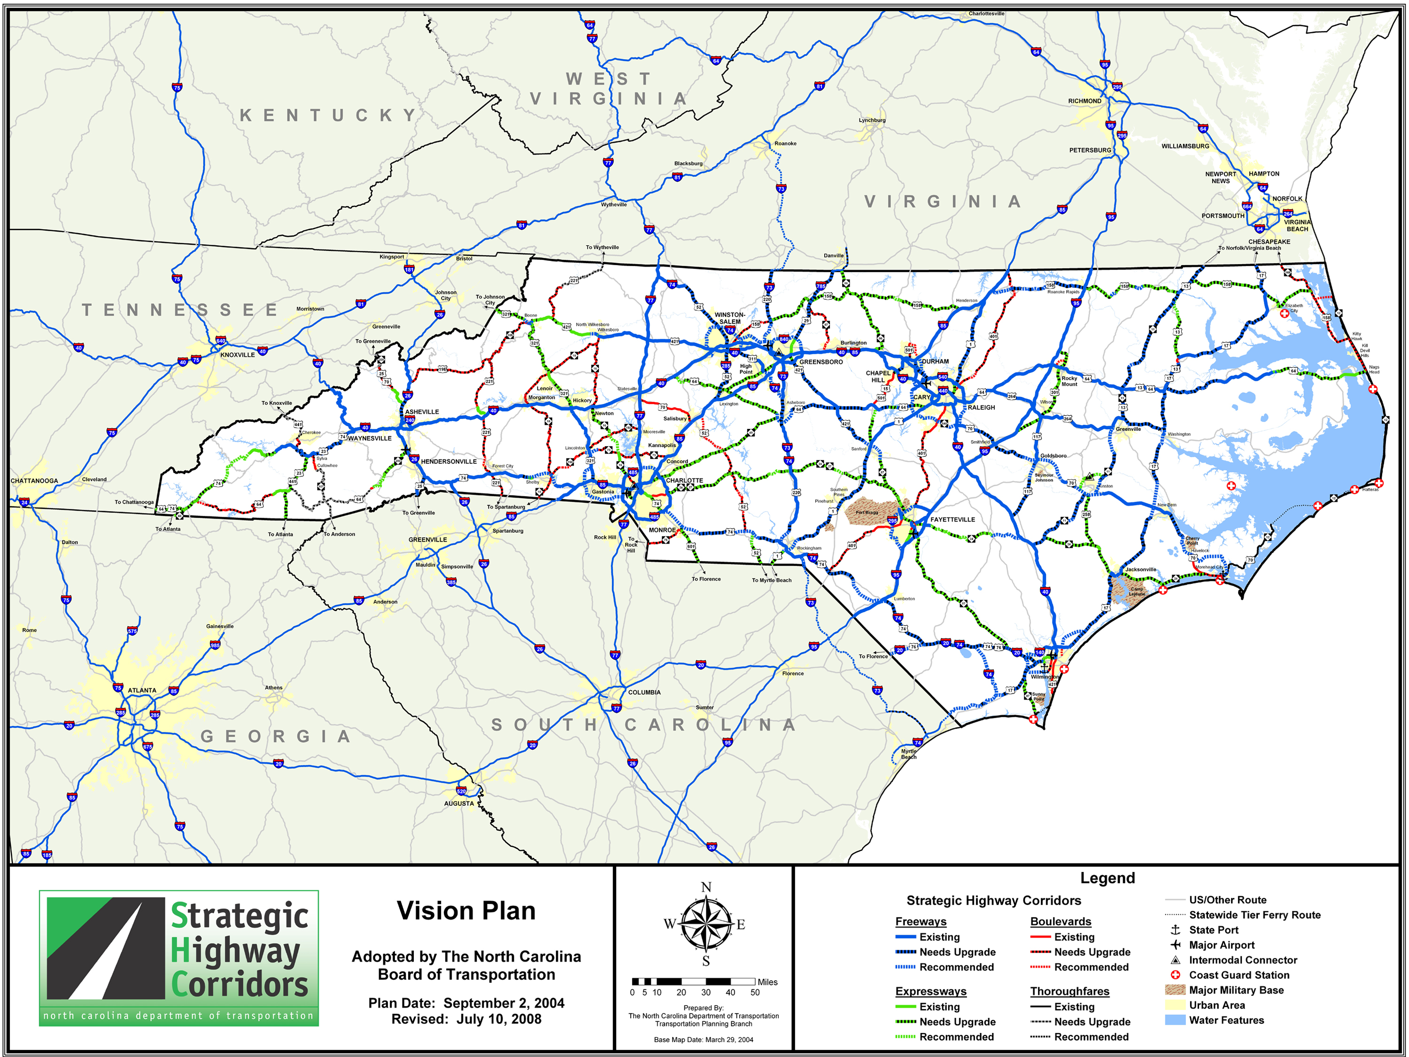
Strategic Highway Corridors
North Carolina STC Master Plans

Slide 6
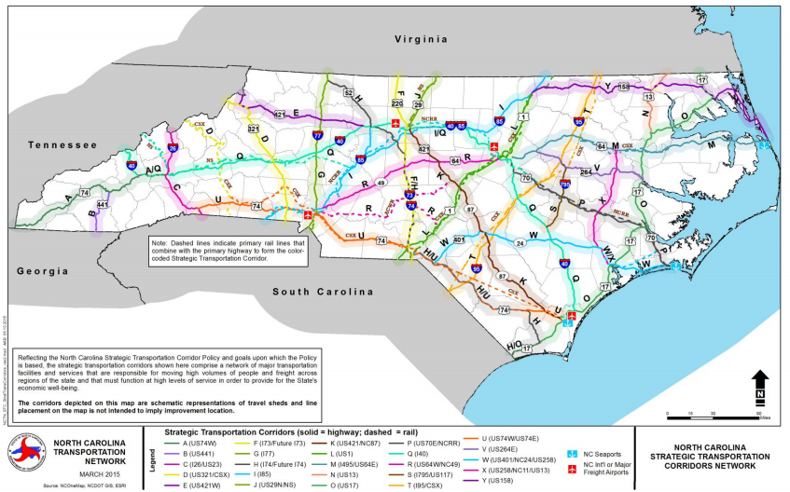
Strategic Transportation Corridors
North Carolina STC Master Plans

Slide 7
North Carolina STC Master Plans
US 74
From I-26 to Wilmington

Slide 8
Corridor Inspections
North Carolina STC Master Plans
Inspection Dates: March 5-7
Areas of Focus
Travel experience
Major connections
Major land uses
Physical/environmental (human and natural) constraints
Highlighted issues

Slide 9
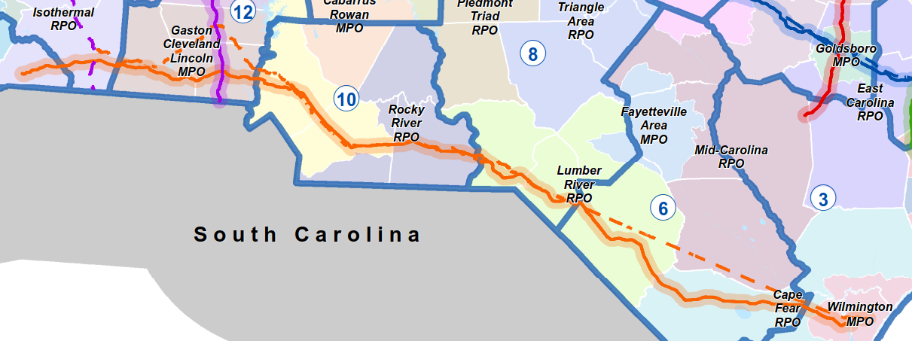
U.S. 74 From I-26 to Wilmington
North Carolina STC Master Plans
Freight route from Wilmington to Charlotte
Major connections to I-74, I-95, I-85, I-77, I-40
Interstate, freeway, expressway, and boulevard

Slide 10
U.S. 74
North Carolina STC Master Plans
Provides direct freight movement from the Port of Wilmington to Charlotte Inland Terminal
Major International Airports
Urban Centers and Rural Areas
Variety of land uses along the corridor
Like-minded long-term vision for the corridor
Notes:
For Leigh: US 74 provides a regional direct connection from Wilmington to Charlotte and to the mountains. It connects all of the major interstates in North Carolina and has a variety of facility types along its 275 miles. In our initial meetings with MPOs and RPOs we did hear a desire for a long-term vision for the corridor of a freeway/interstate facility.

Slide 11
Data Collection
North Carolina STC Master Plans
Previous studies and STIP projects
Environmental GIS layers
Local transportation and land use plans
Travel demand models
Ports, airports, and transit inventory
Bicycle inventory / Bike & ped plans
Performance measures
Travel markets and freight flows

Slide 12
Agency Engagement
North Carolina STC Master Plans
Corridor Steering Committee
MPO/RPO staff
NCDOT disciplines and Divisions
FHWA
USMC, Ports, Global TransPark
Meetings with MPO/RPO Staff, TAC, TCC

Slide 13
Stakeholder Engagement
North Carolina STC Master Plans
Sunny Point Military Ocean Terminal
Schools: Southeast Community College and Cape Fear Community College
Public Transit Providers
Municipal and County Managers
Chambers of Commerce
New Hanover Regional Medical Center
Health Services, Emergency Management
Walmart, other large businesses

Slide 14
Public Engagement
North Carolina STC Master Plans
Via MPO/RPO and Stakeholders:
PublicInput.com
MetroQuest
Stakeholder Workshop
One on One interviews

Slide 15
Plan Deliverable: Unified Statewide Vision per Corridor
North Carolina STC Master Plans
Corridor Map
Corridor Profile
Problem Statement for Sub-Corridors
Corridor Access Management Recommendations
Strategic Corridor Conditions Report
Developing Strategies and Identifying Recommendations Report

Slide 16
Elements Potentially Included
North Carolina STC Master Plans
Facility type
Multimodal accommodations
Access management / UDO change
Sub-corridors
Sequencing of potential projects
Purpose and need statements
Timeframe
Interim strategies

Slide 17
Master Plan Next Steps
North Carolina STC Master Plans

Slide 18
Questions?
North Carolina STC Master Plans

