Slide 1
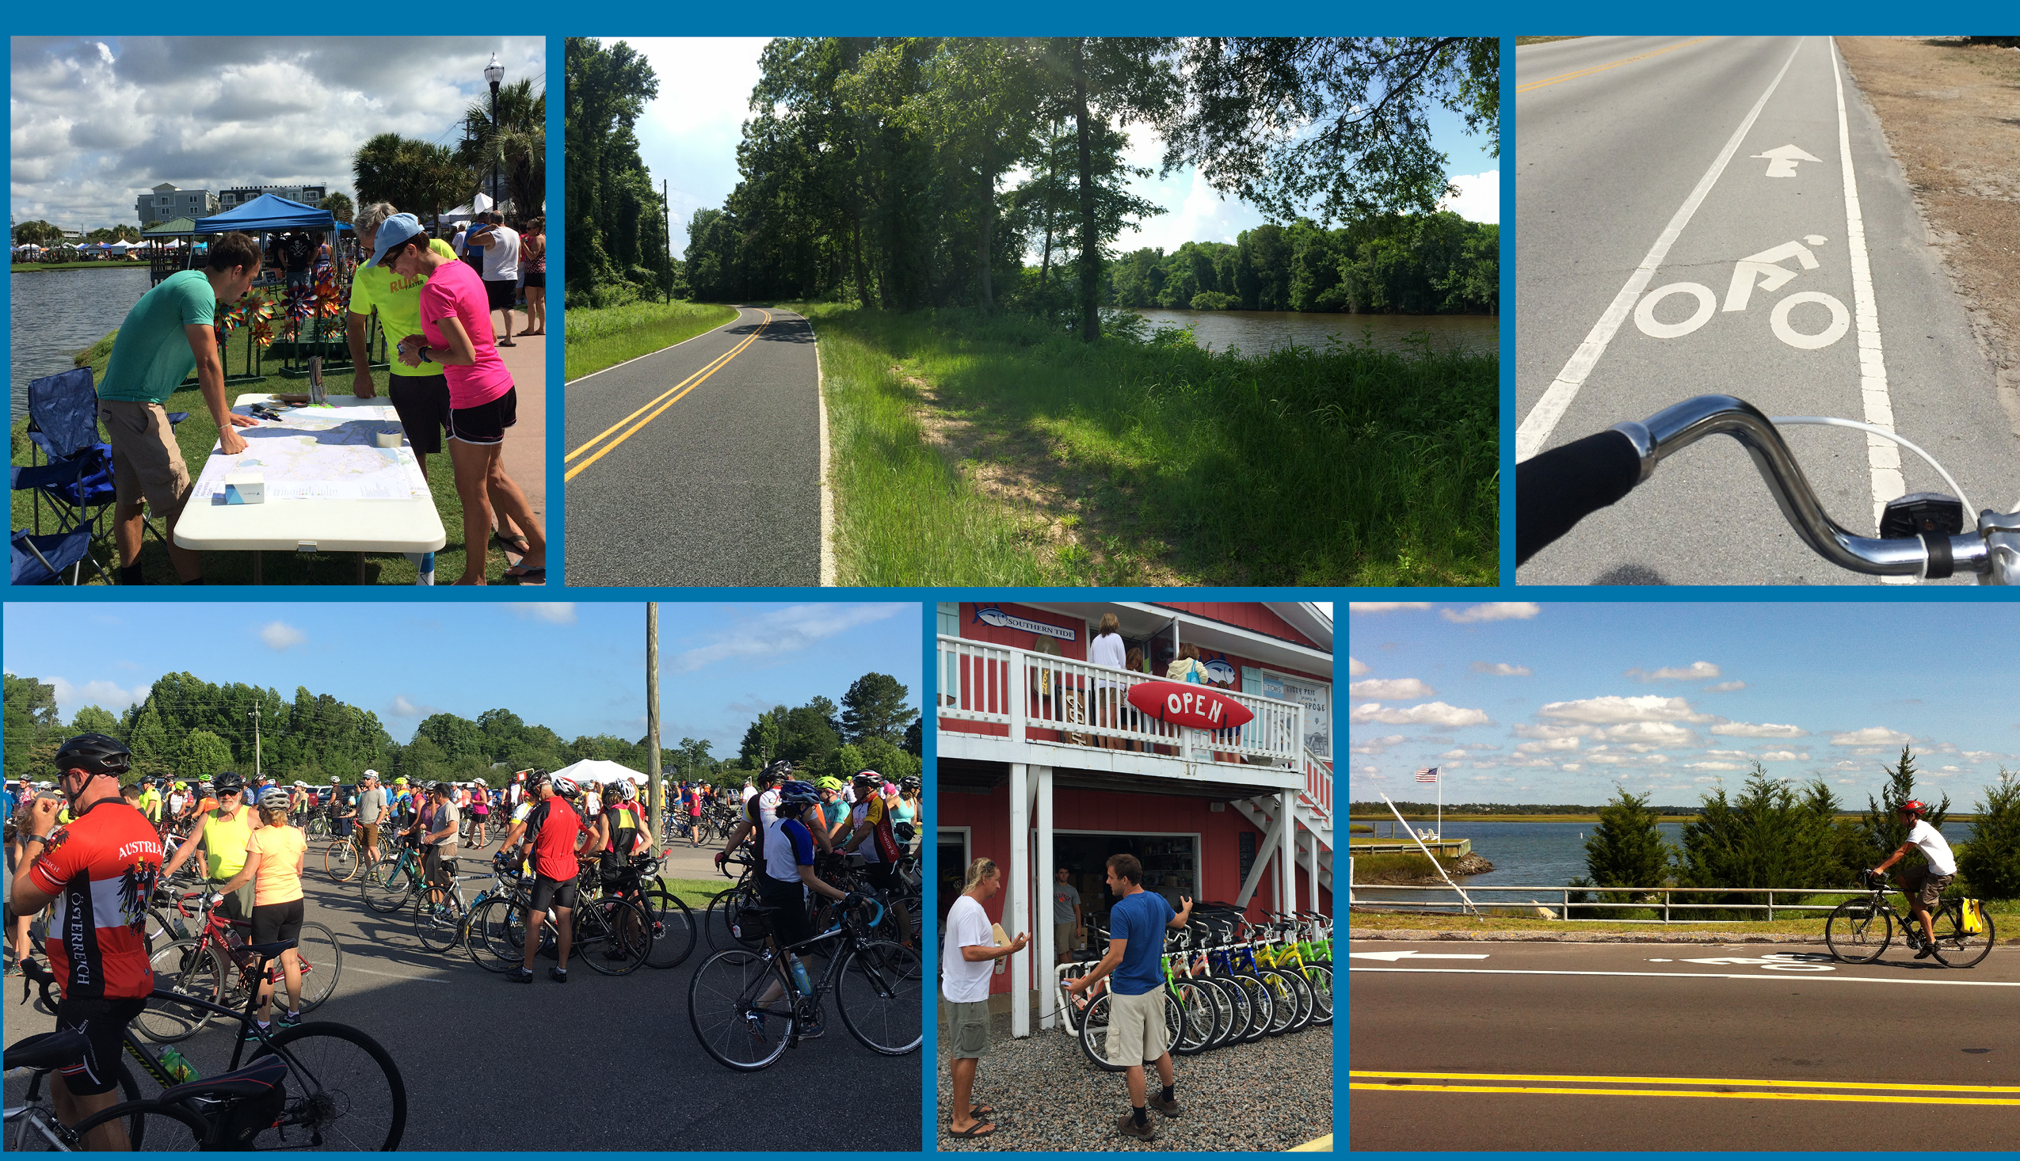


Overview Presentation
Spring 2017

Slide 2
Presentation:
Background & Purpose
Planning Process
Types of Recommendations
How to Use this Plan

Slide 3

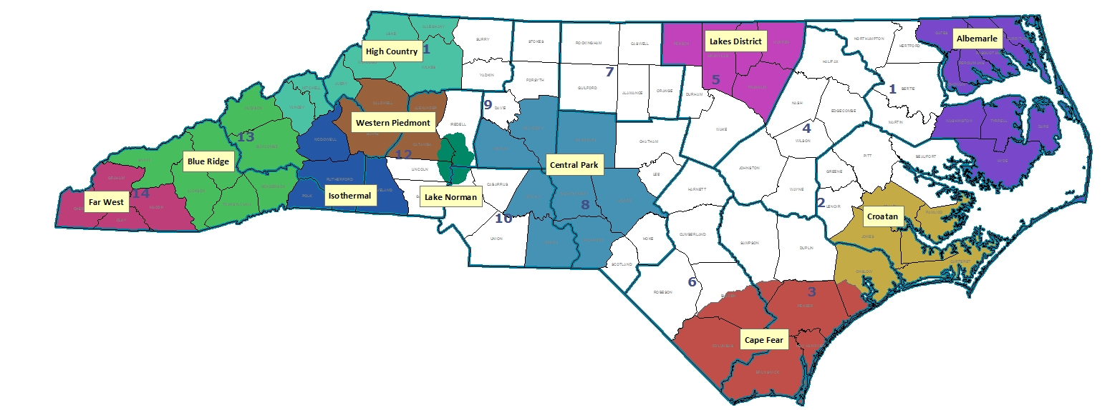
Background
NCDOT supports regional bicycle plans across the state to create safe and connected routes for bicycling.
The Cape Fear Council of Governments led a year-long process to develop the first bicycle plan for this region.

Slide 4
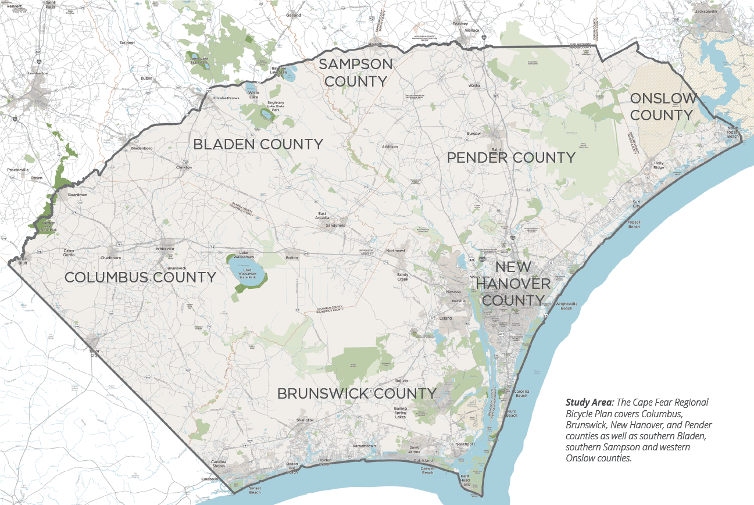
Background: Study Area

Slide 5
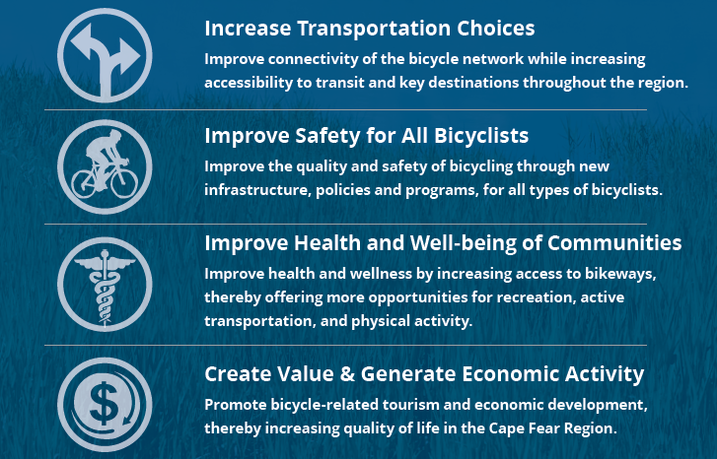
Background: Purpose

Slide 6
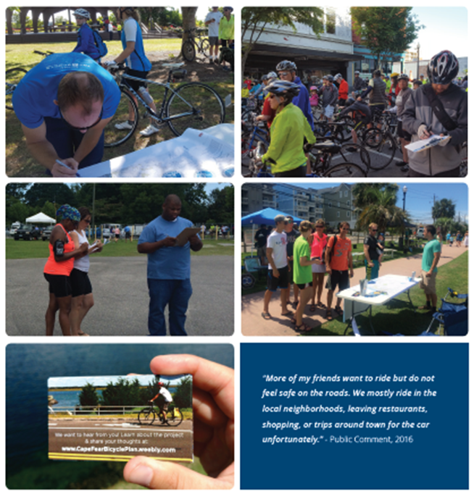
Planning Process: Timeline
Spring 2016
  Project kick-off, data collection & outreach sessions
Summer 2016
  Analysis of bike routes & draft network
Fall 2016
  Draft plan & plan review
Winter 2016-17
  Plan revisions & outreach sessions
Spring 2017
  Final plan & presentations
Notes:
Nearly 500 participants in public comment forms
Over 200 public comments through online mapping
Public outreach at over a dozen community events

Slide 7
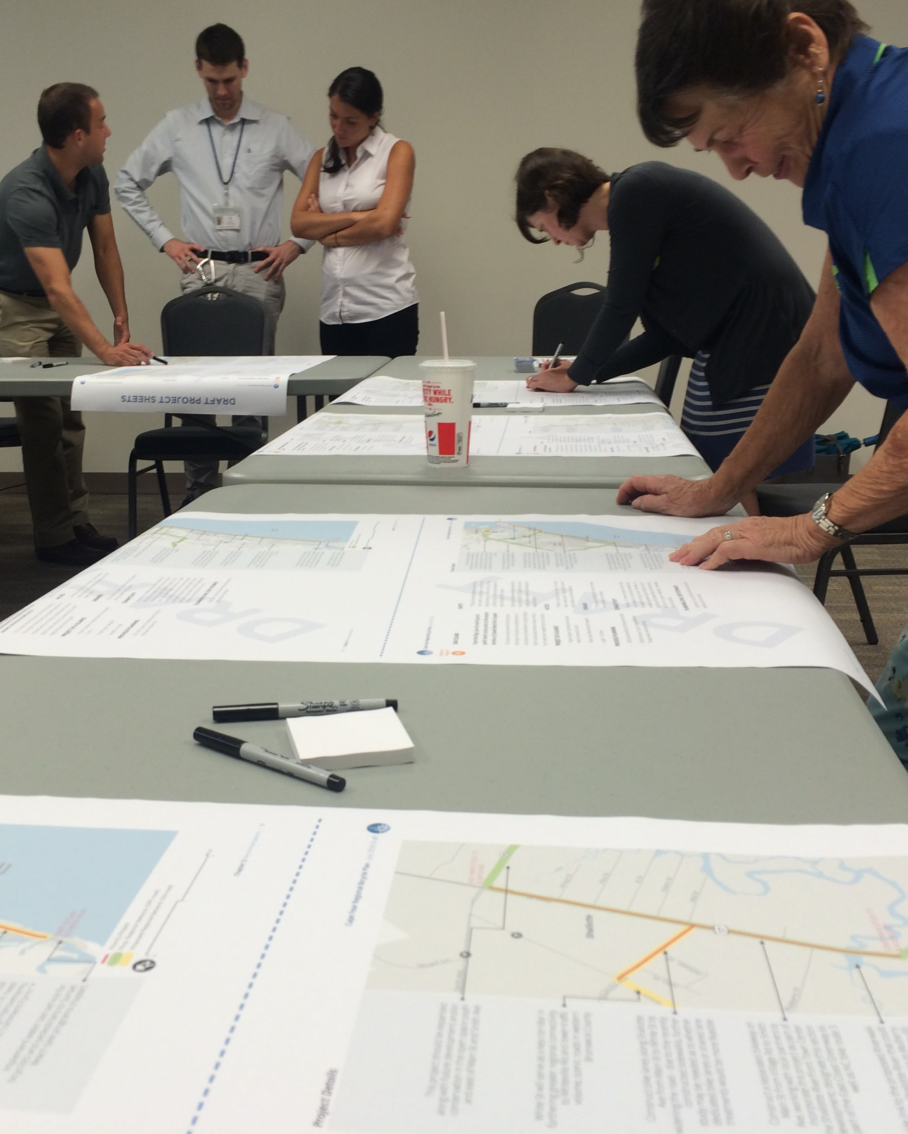
Planning Process: Steering Committee
Allen Serkin, Cape Fear Council of Governments
Patrick Flanagan, Down East/East Carolina RPO
Peggy Holland, Jacksonville Urban Area MPO
Mike Rutan, Mid-Carolina COG/RPO
Suraiya Rashid Motsinger, Wilmington MPO
Beth Doliboa, Wilmington MPO
Patrick Riddle, NCDOT Division 3
Joe Bailey, NCDOT Division 6
John Vine Hodge, NCDOT Division of Bicycle & Pedestrian Transportation
Kirstie Dixon, Brunswick County
Bethel Paris, Cape Fear Cyclists/East Coast Greenway
Hiram Marziano, City of Whiteville
Gary Lanier, Columbus County
Stephen Smith, Columbus Trails Alliance
Chris O'Keefe, New Hanover County
Pat O'Mahoney, Pender County
Eddie Madden, Town of Elizabethtown
Niel Brooks, Town of Leland
Jacob Vares, Town of Oak Island
Niles Barnes, East Coast Greenway
Notes:
5 official committee meetings
Multiple MPO/RPO presentations
Multiple NCDOT division meetings
Draft plan review & feedback

Slide 8
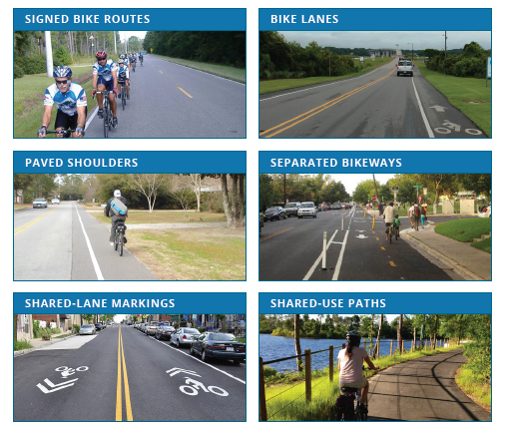
Types of Recommendations
Notes:
The Plan’s network of recommendations aims to connect regional destinations using a variety of facility types, including the ones shown here.

Slide 9
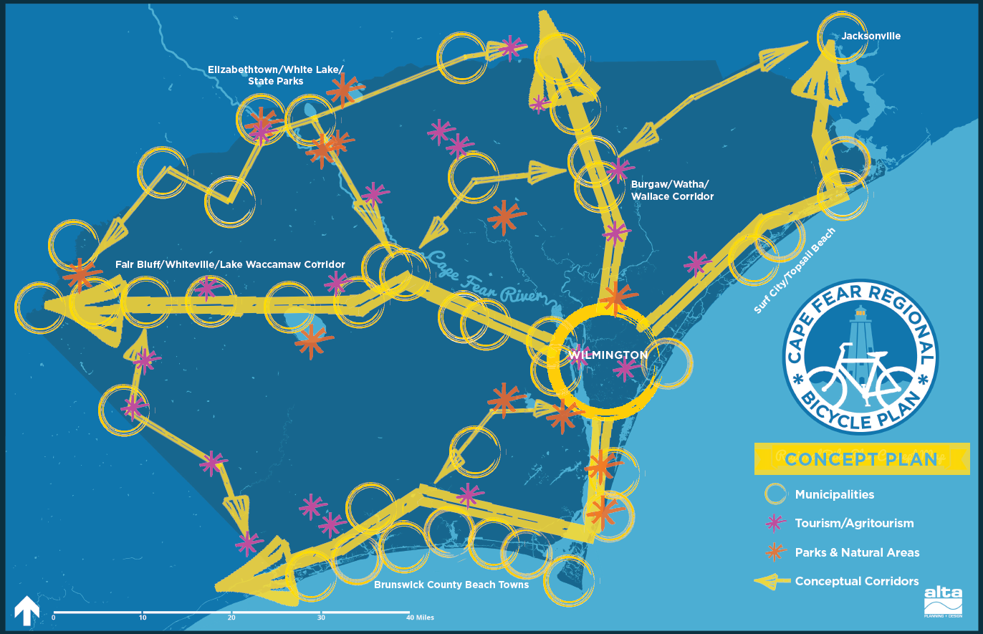
The Big Picture: Conceptual Corridors
Notes:
Regional hubs, such as municipalities and tourism destinations are connected by a system of trails and on-road bicycle routes.

Slide 10
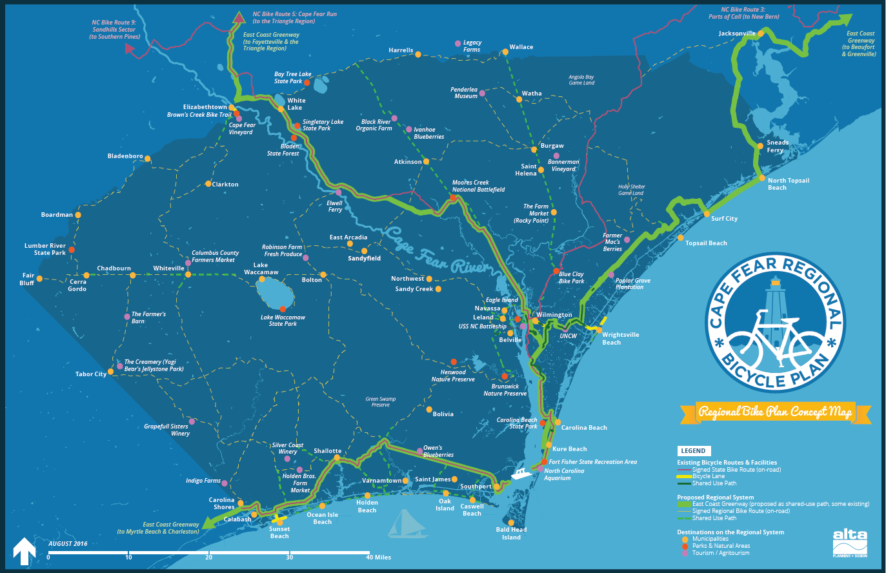
Overall Network of Recommendations
Notes:
The plan builds upon currently designated and planned routes, such as the East Coast Greenway (shown here in green) and signed state bicycle routes (shown here in red).

Slide 11
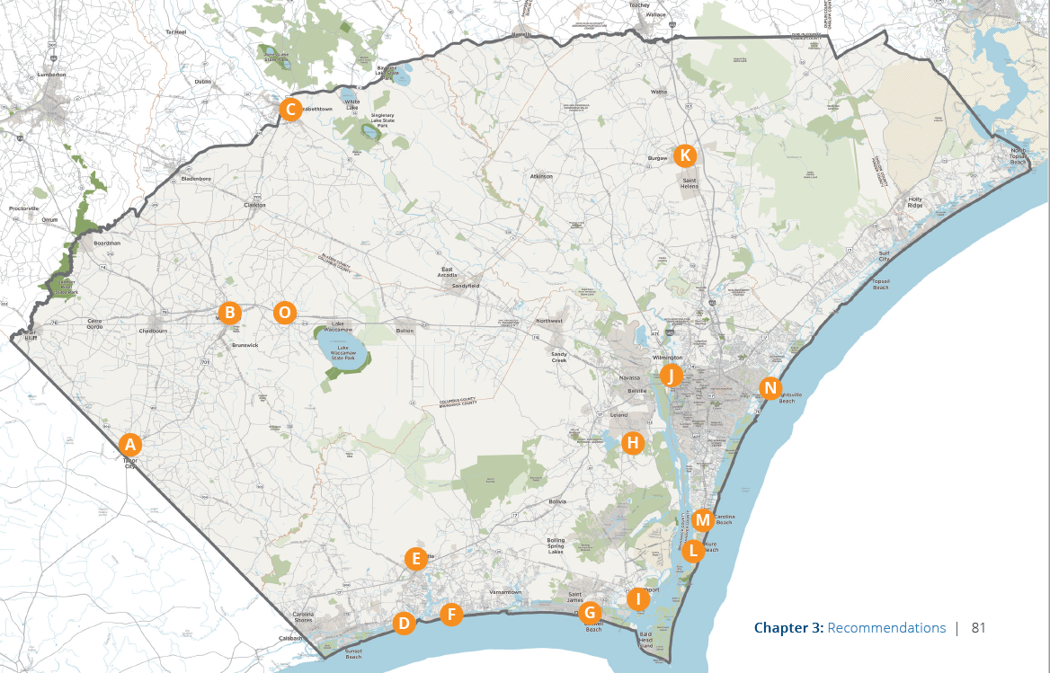
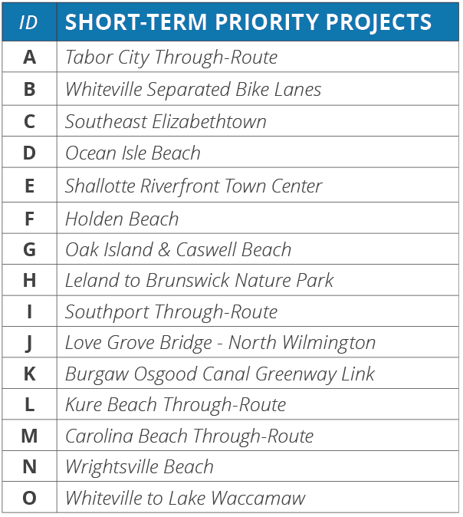
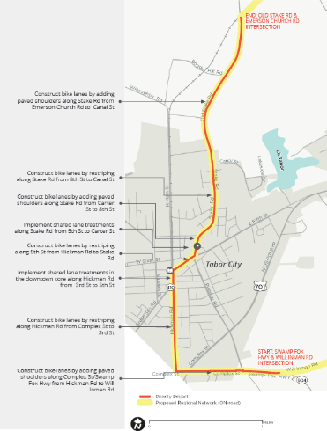
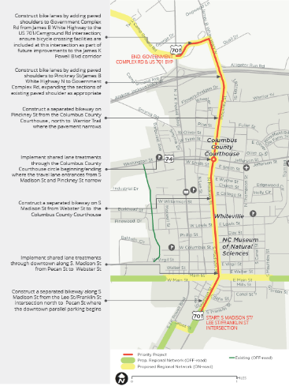
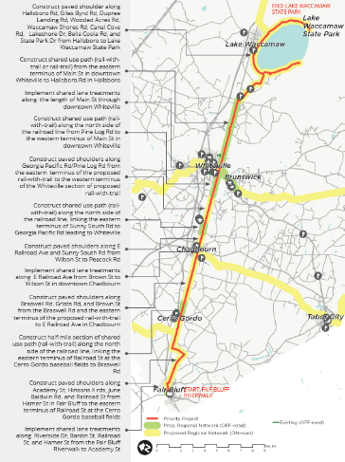
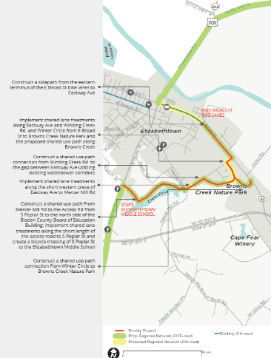
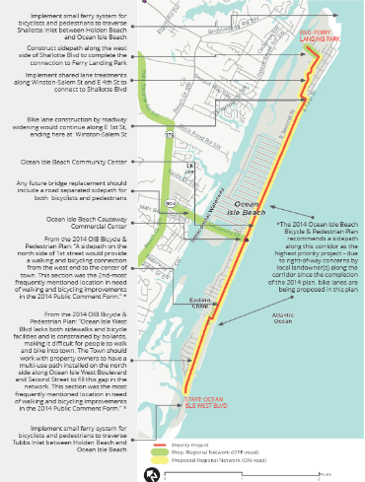
Plan also features detailed recommendations for 15 priority projects…
Notes:
Plan also features detailed recommendations for 15 priority projects
Each of projects listed here has a two-page project description with an annotated map and detailed cost estimates.
The projects draw upon and expand upon existing local and regional plans, and were vetted by representative steering committee members.

Slide 12
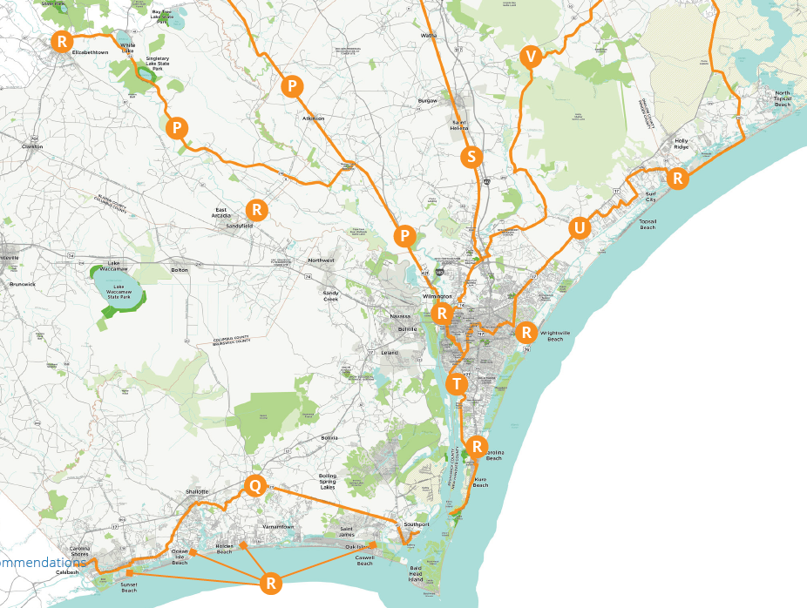
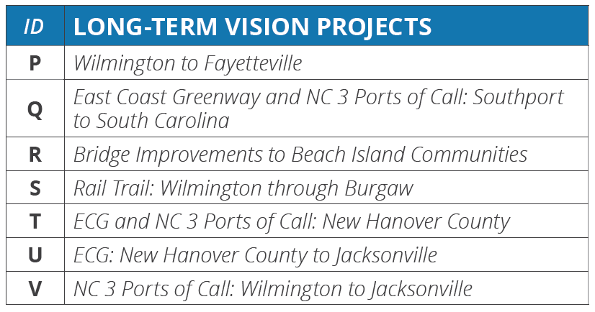
…and establishes vision for long-term projects.
Notes:
The plan also establishes a vision for longer-term projects, such as major greenway trails that will take longer to implement due to right-of-way and funding needs.
A brief overview and description is provided for each of the projects listed here.

Slide 13
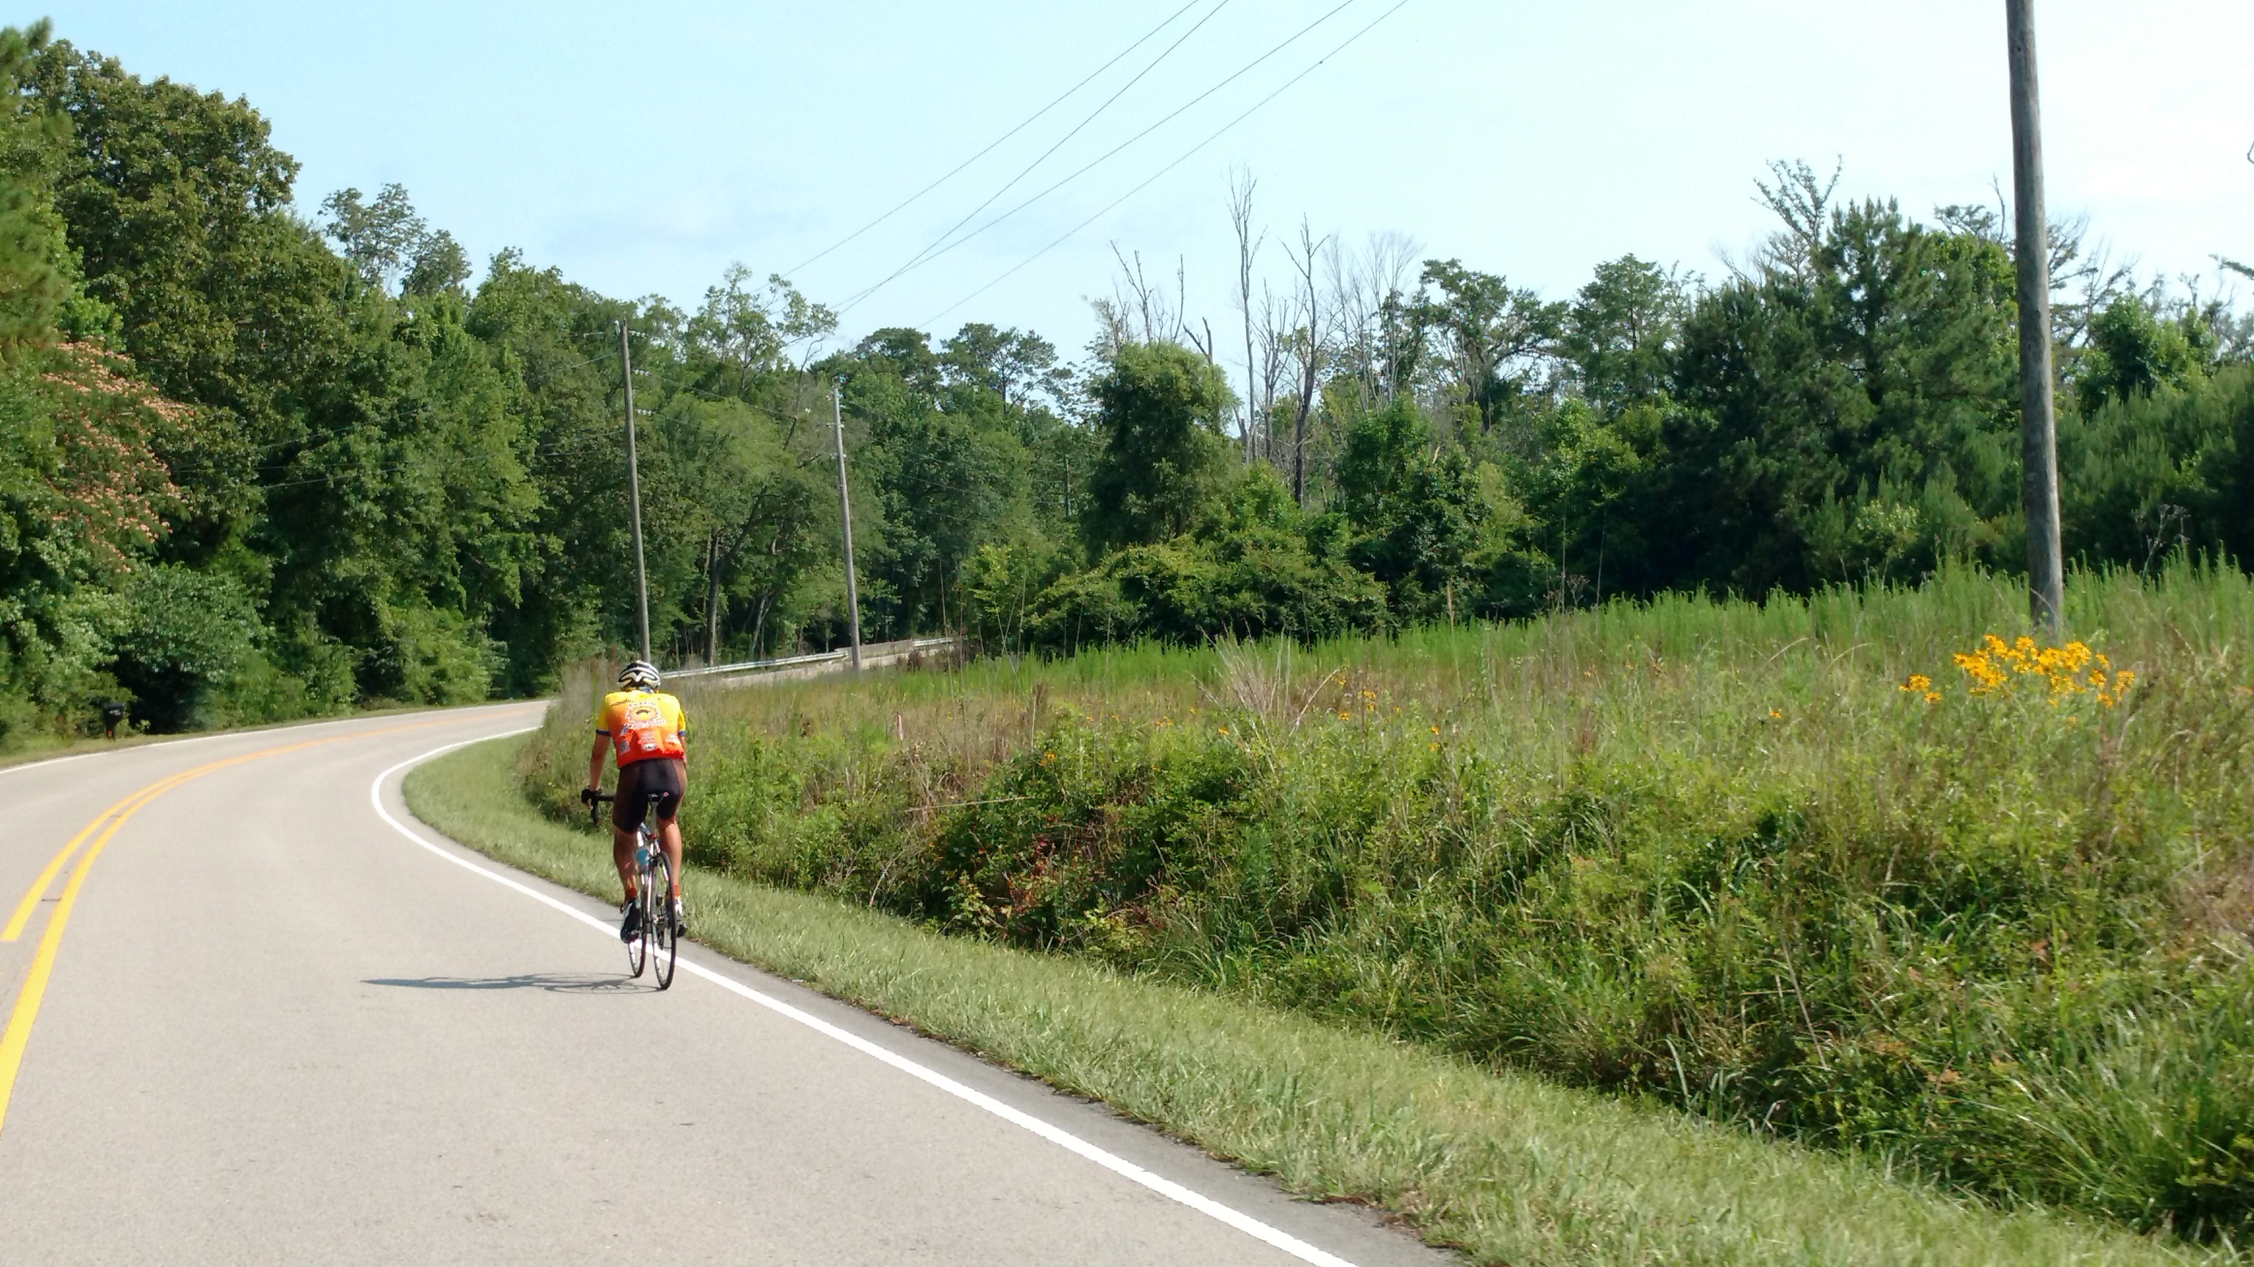
Paved shoulder example
Notes:
These images provide an example of what the project recommendations might look like “on the ground”.

Slide 14
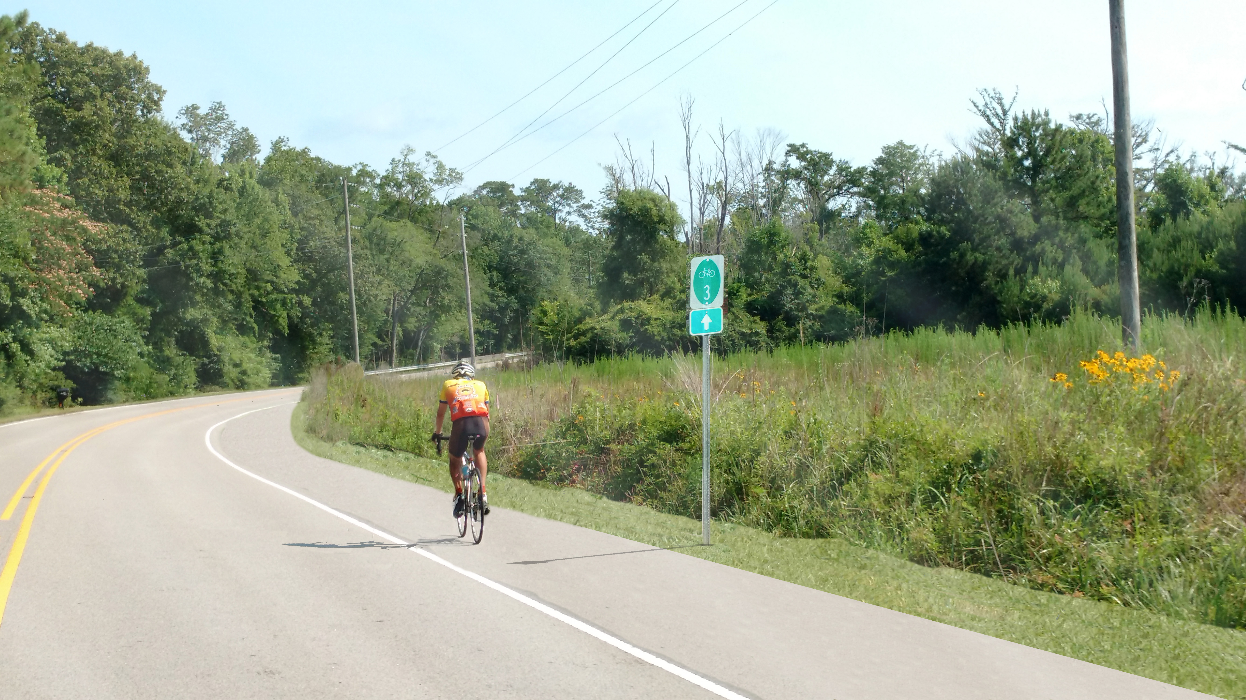
Paved shoulder example
Notes:
These images provide an example of what the project recommendations might look like “on the ground”.

Slide 15
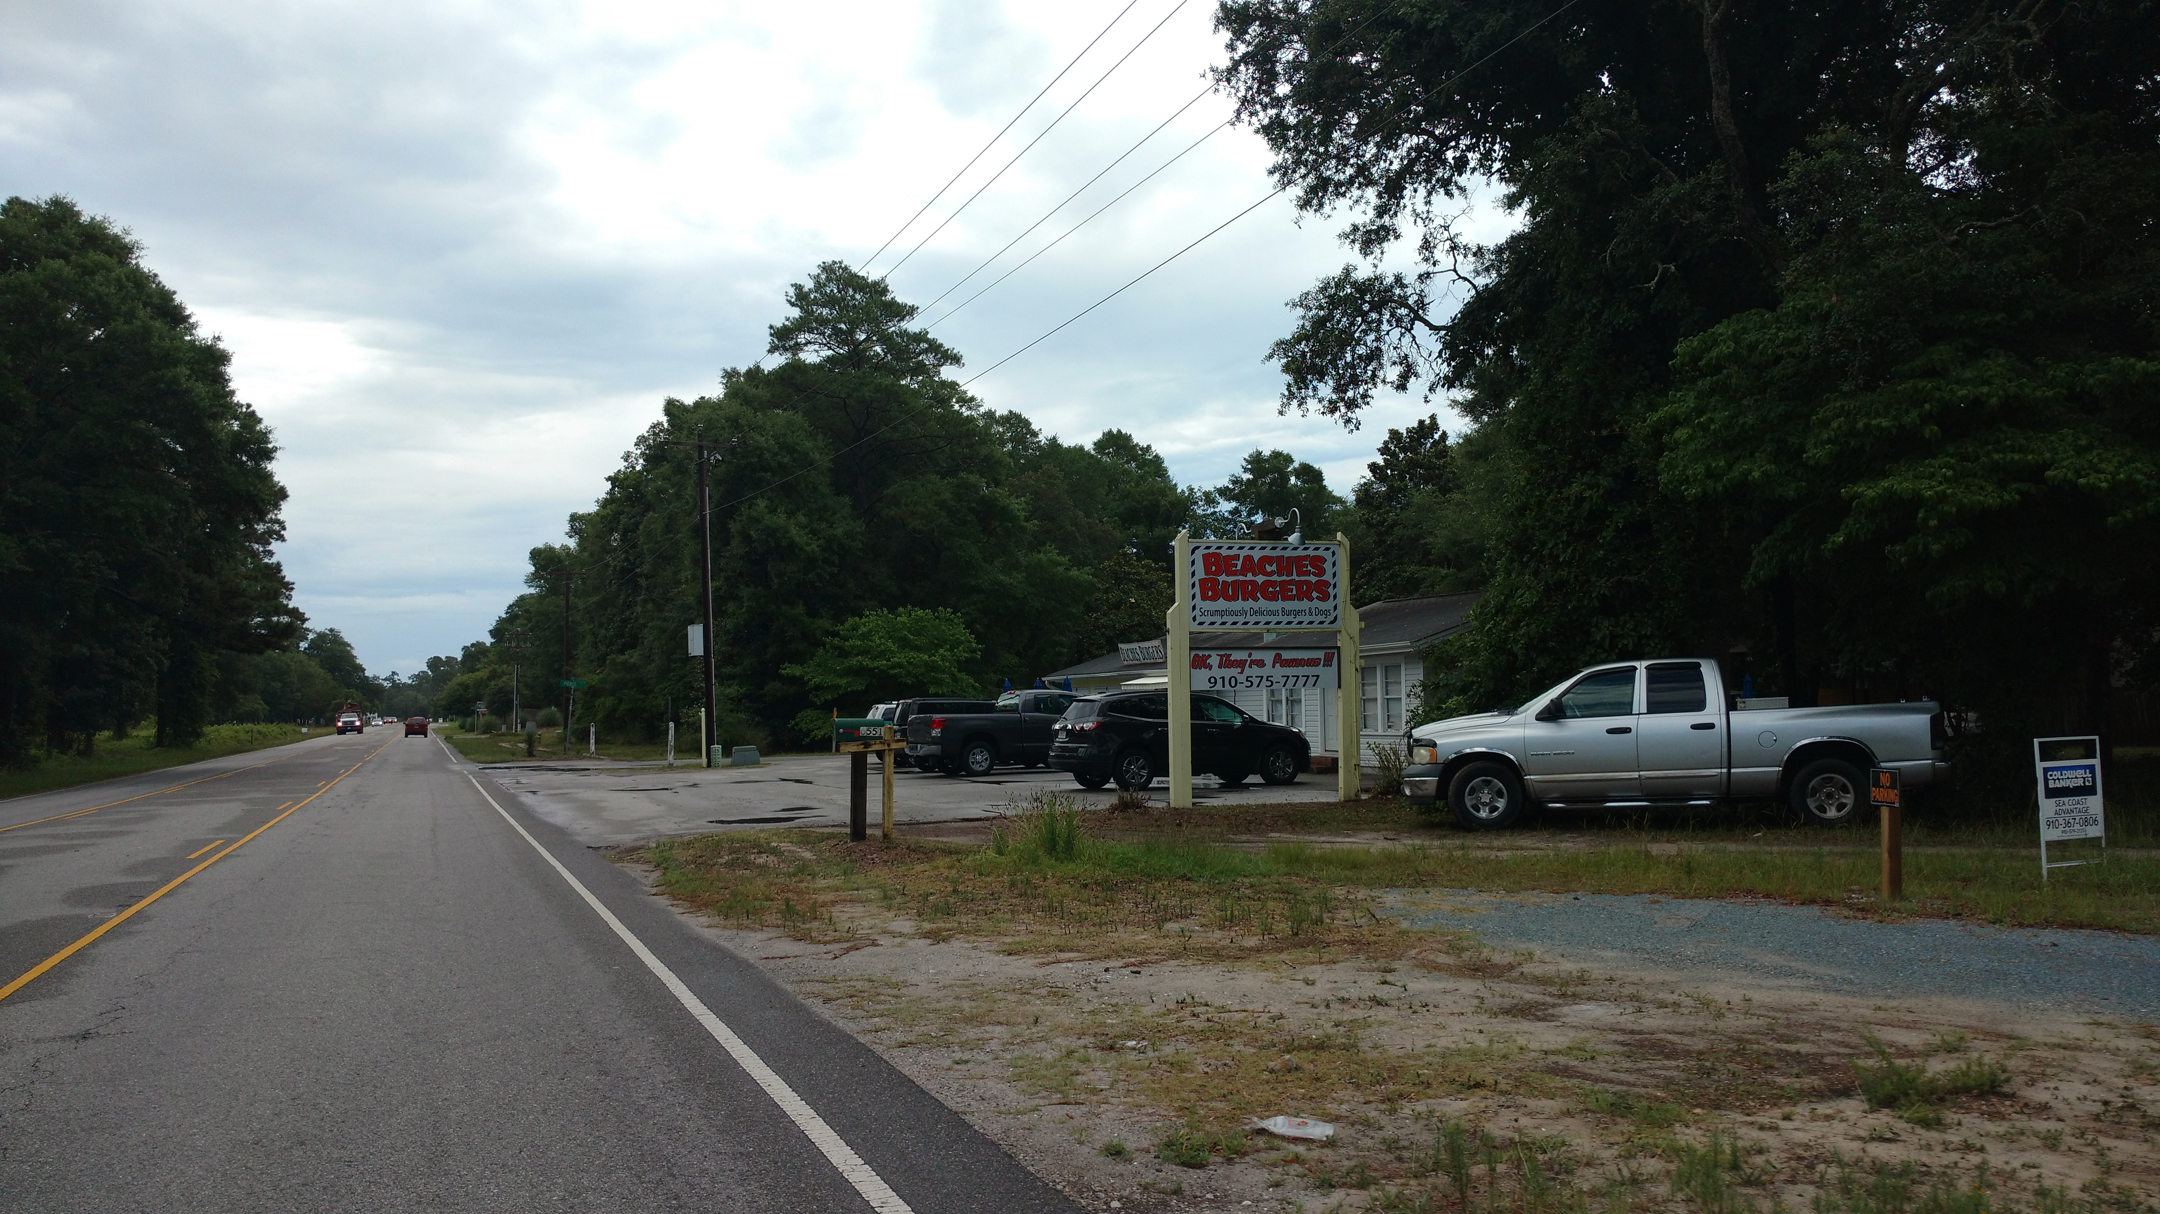
Shared-use path example
Notes:
These images provide an example of what the project recommendations might look like “on the ground”.

Slide 16
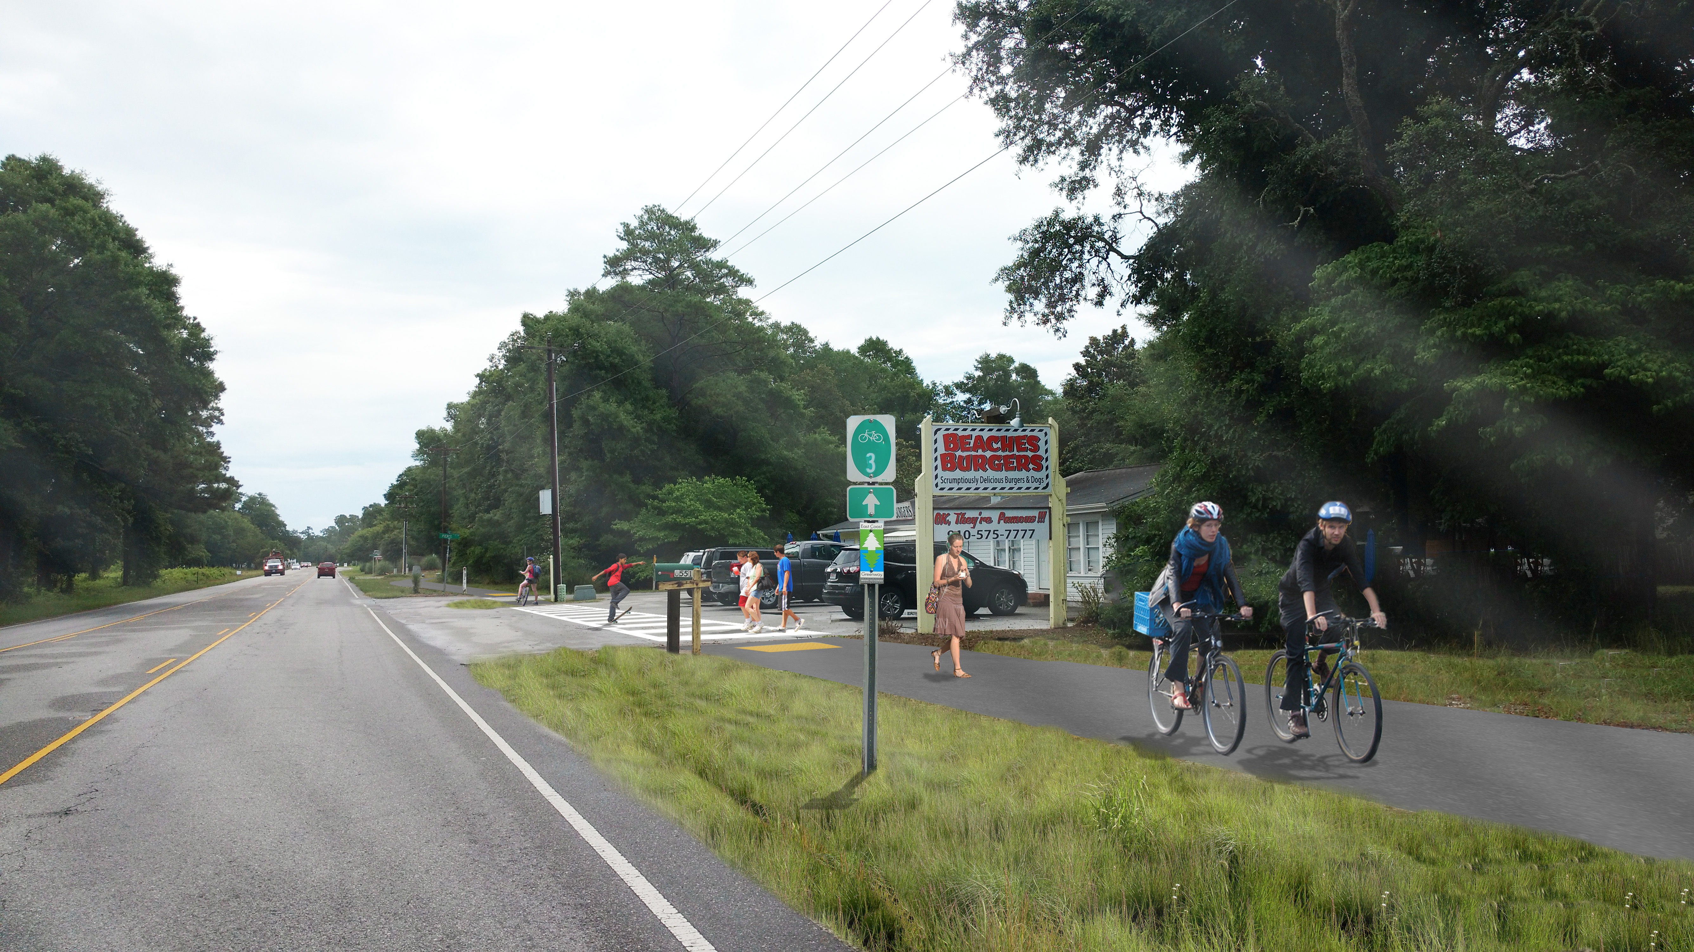
Shared-use path example
Notes:
These images provide an example of what the project recommendations might look like “on the ground”.

Slide 17

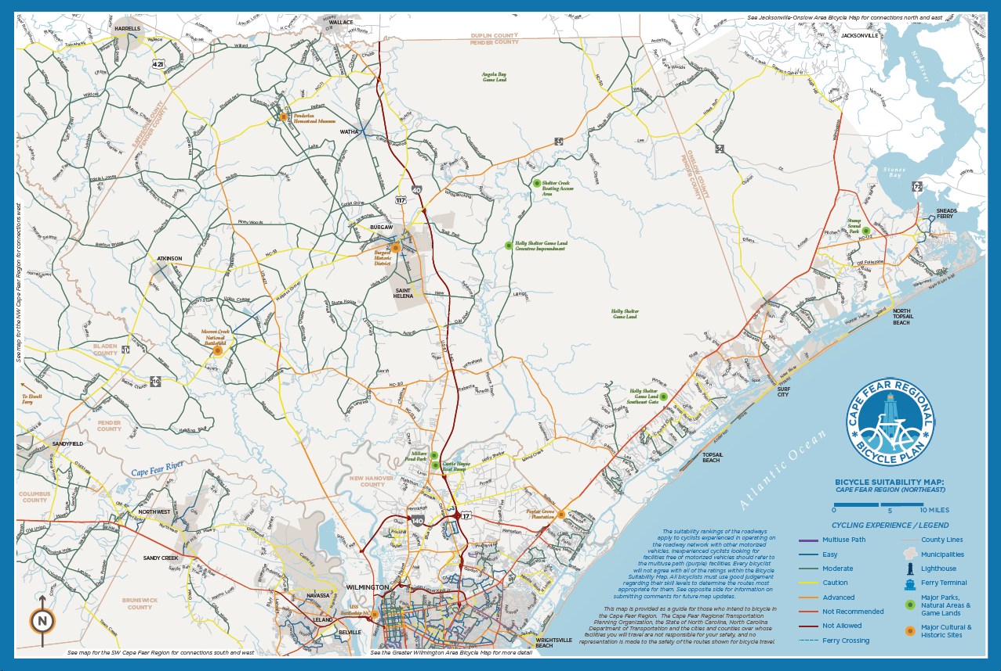
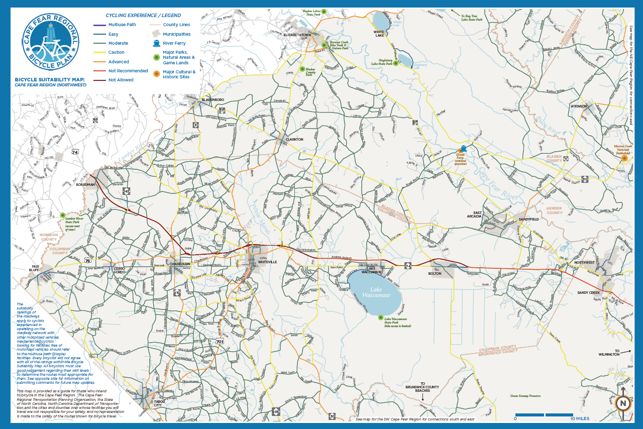
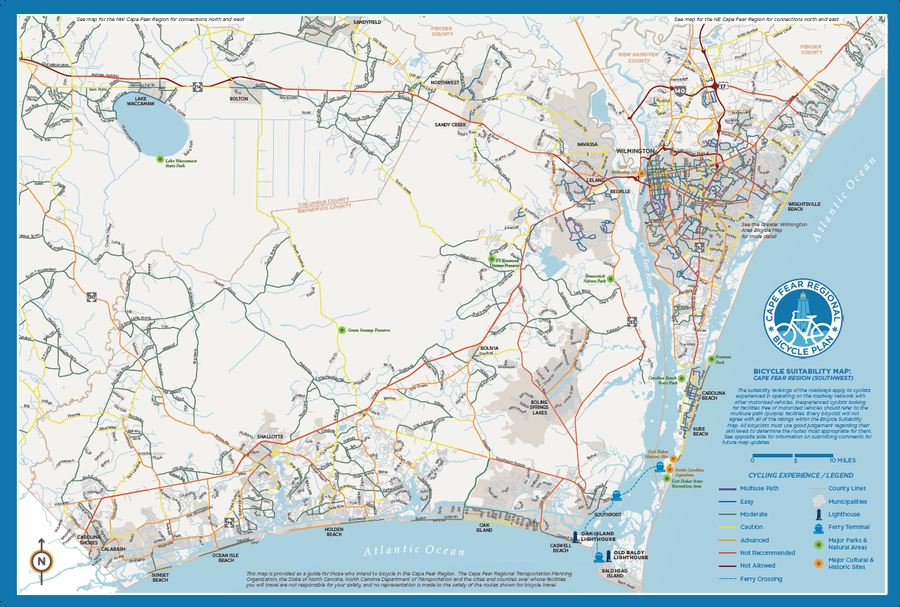
Brochure Maps
Executive Summary brochure map
3 sub regional brochure maps
In development as of Spring 2017
Notes:
Each of the brochure maps will feature information about:
The level of bicycling comfort on the region’s roadways today.
Basic bicycling safety considerations, and where to find more information.
Basic information about local and regional tourism.

Slide 18
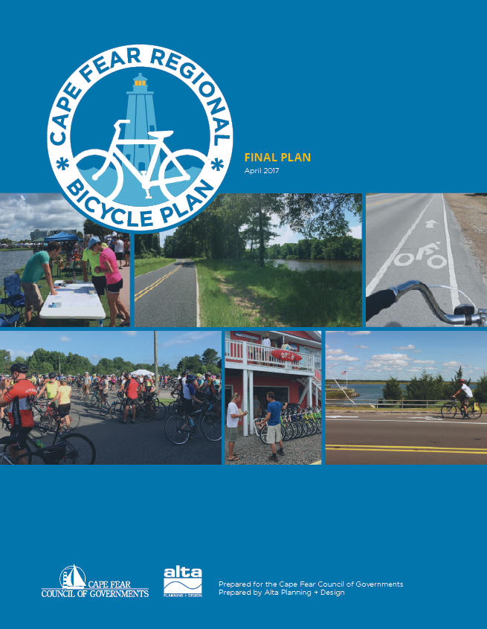
How to Use this Plan
Helps inform decision-making for roadway projects
Project sheets and cost estimates inform specific projects
Ideas for programs, policies, funding & design
Cite the plan in grant applications and funding requests
Use brochure maps to promote bicycling and tourism
Notes:
See points on slide.
A resolution of support does not replace any local plans nor dedicate any funding, but rather indicates a willingness to support the Plan’s recommended bicycle projects and programs.
Plan adoption does the same, but goes further in making the case to outside funding partners (grants, state funding, etc.) that there is a locally supported plan in place, and that the community is committed to implementation over time.

Slide 19
Thank you!

