Slide 1
Welcome
Welcome
A strategic transportation plan connecting communities across North Carolina, focused on creating a more responsive, diverse, and inclusive transportation system for keeping people and freight moving safely and efficiently.
A strategic transportation plan connecting communities across North Carolina, focused on creating a more responsive, diverse, and inclusive transportation system for keeping people and freight moving safely and efficiently.
Notes:
Key Message: Welcome to this conversation about NC Moves 2050, North Carolina’s long range multimodal transportation plan.
Suggested Narrative:
Welcome! North Carolina is updating its long range multimodal transportation plan. This plan is an important initiative for North Carolina and your participation is critical to its success. The purpose of this meeting is to get your response to changes coming to your region in order to better inform the development of a statewide plan that considers the needs and challenges of all communities.

Slide 2
Agenda
NC Moves 2050
Planning for Uncertainties
What Do You Think?
Overview
Making Your Voice Heard
Notes:
Key Message: These are the items we will cover today.
Suggested Narrative:
Over the course of this presentation we will provide and overview of the NC Moves 2050 process and why it matters for you. We will also share some opportunities for you to make your voice heard as the planning process moves forward. The focus of today’s presentation will be on planning for uncertainties, around which we will engage you in a couple of questions.

Slide 3
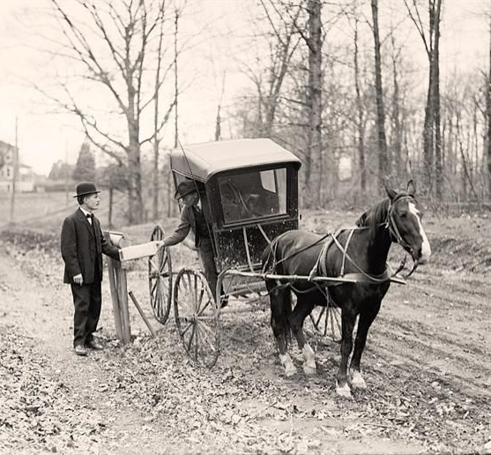
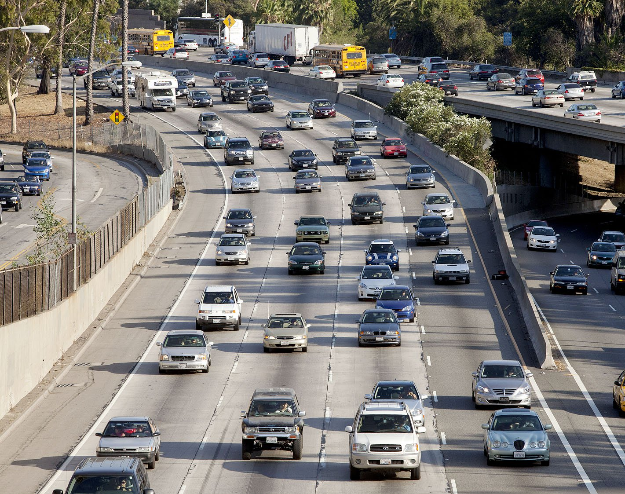
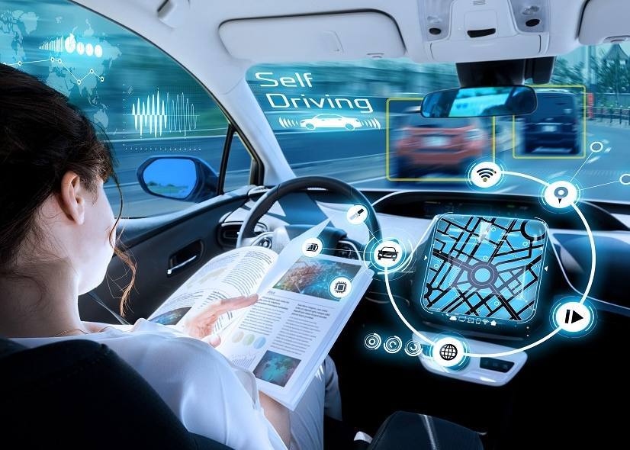
Change is Coming
NC Moves 2050
1909
2019
2050?
110 years
30 years
Notes:
Key Message: Transportation plays a significant role in the vitality of our communities. Change is coming and we must plan for it.
Suggested Narrative:
Transportation plays a significant role in the mobility, economic health, and quality of life of our communities. It shapes growth by providing access to land and shapes policy in areas related to air quality, environmental resources, social equality, urban growth, economic development, and safety and security. The transportation planning process is the process of developing strategies to support our transportation system in a way that advances our long-term goals.
And what an exciting time to be in the field of transportation, we are living during a time of revolutionary change, not unlike when we saw transportation move from horse and buggy to automobile, and just look at how that changed our lives and our communities. In most of our lifetimes we are going to experience such a revolutionary change. Hard to imagine? Just think about how Netflix transformed cable TV. New and emerging technologies could have similar impacts on transportation.
Given the changes on the horizon, and the important role that transportation plays in shaping our communities, we must plan for the future.

Slide 4
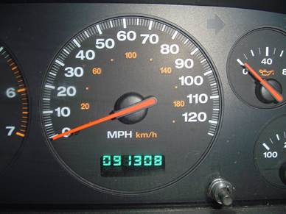
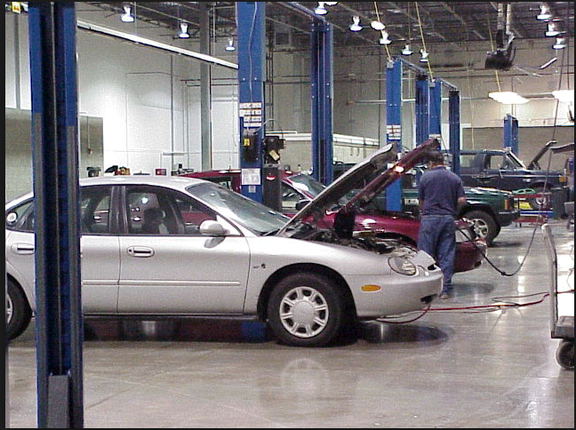
NC Moves 2050
1
2
Current Assessment
(Where are we now?)
Planning for Uncertainties
(Where could we go?)
Mileage on Current Car
Cost of Repairs
Future gas prices
Family changes
Changing jobs
Reliability
3
4
Possible Futures
(How could we prepare?)
Action Plan
(What’s our path forward?)
Increased earnings
Savings Plan
Purchase new car
Grow my family
Move closer to multimodal options
Purchase used car
Notes:
Key Message: The planning process we are undertaking for NC Moves 2050 can be explained by drawing analogies to car ownership. Both include assessing current conditions, planning for uncertainties, imagining possible futures, and develop an action plan.
Suggested Narrative:
The planning process we are undertaking over the next 2 years is referred to as NC Moves 2050, North Carolina’s long range multimodal transportation plan. This process can be explained by drawing analogies to car ownership, something that most of us have experienced in our lifetimes.
Current Assessment
How many miles on my current car?
Does it meet my needs?
What is the state of repair?
How much is my monthly payment?
Challenges and Opportunities
Am I concerned about reliability?
What is my future earning potential?
What impacts my insurance rating?
Will job changes impact the distance I travel?
Will family changes impact the type of car I need?
Possible Futures
Increased earnings give me more buying power
Move farther from work and my fuel costs go up
Start a family or grow my family
Move to and area with good multimodal options
Action Plan
Create a savings plan to cover the cost and maintenance of the car
Research different makes and models along with safety features
Research different dealerships or buying options
Purchase your new car
Just like with the car analogy, NC Moves 2050 includes assessing current conditions, planning for uncertainties, imagining possible futures, and developing an action plan.

Slide 5
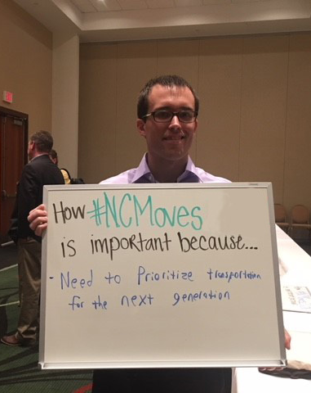
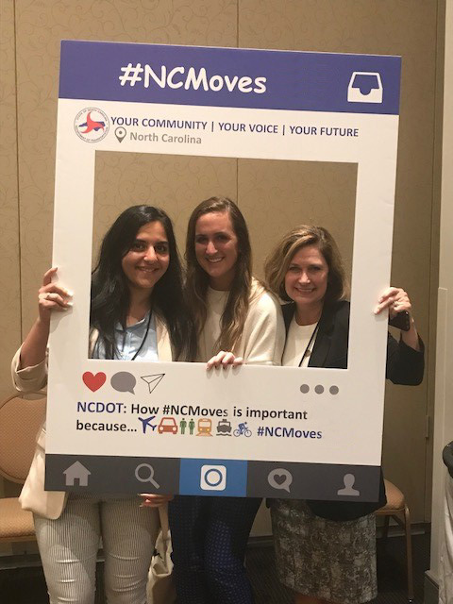
Your Voice Matters
NC Moves 2050
Notes:
Key Message: In planning for North Carolina’s transportation future, your voice matters, so make your voice be heard.
Suggested Narrative:
While NC Moves 2050 can be compared to car ownership, we all know it’s much bigger than that. We are not buying a car for a specific individual or family, we are developing a plan for our entire state, not just current citizens, but future generations. Your voice matters so make your voice be heard.

Slide 6
Why Does Your Voice Matter?
NC Moves 2050
We are partners in the planning process
NC Moves 2050 will
Guide future transportation policies and investments
Address things you care about: bicycle & pedestrian policies, complete streets policy, connections to health care, quality of life, inter- and intra-state connections, funding and funding priorities, technology and electric vehicles
Set the vision for transportation in our state
Your input is critical to making sure this plan meets the needs of all North Carolinians
Notes:
Key Message: Your voice matters because this plan will help guide future transportation policies and investments, and these decisions can have a direct impact on your community.
Suggested Narrative:
NC Moves 2050 is North Carolina’s long range multimodal transportation plan that will help guide North Carolina’s future transportation policies and investments. Clearly NC Moves 2050 is an important initiative for the state, but why does it matter to you?
We are partners in the planning and implementation of transportation projects. We have heard that you care about transportation options, including policy changes that impact bicycles and pedestrians and complete streets policy. We know that you care about connections to health care and other activities important for the quality of life for your communities, and that those connections may not always be within North Carolina, but may mean better connections to adjoining states. We know you care about funding and how the state’s policies and priorities might impact funding in your area. Many of you have also heard about North Carolina’s vision for integrated technology and electric vehicles, and may worry that your community will get left behind because many rural parts of our state do not have reliable broadband internet.
The population in our state is growing and the demands on our infrastructure are great. The prosperity of our state and our regions relies heavily on strategic infrastructure investment to encourage economic growth while maintaining a high quality of life. We need a plan and a vision for advancing transportation in our state.
You input is critical to making sure this plan meets the needs of all citizens and all communities across the state.

Slide 7
NCDOT.GOV/NCMOVES
7
Notes:
Key Message: There will be opportunities for you to stay involved throughout the life on the plan. Visit the project website to stay up to date on project activities, and talk about the project on social media.
Suggested Narrative:
There will be opportunities for you to stay involved throughout the life on the plan. Visit the project website to stay up to date on project activities, and talk about the project on social media. More information about NC Moves 2050 can be found online at this web address or on social media using the #NCMoves hashtag

Slide 8
Promote the Public Comment Map
NC Moves 2050
Interactive Map - Over 600 Responses So Far – Open until April 30th
www.ncdot.gov/ncmoves
Notes:
Key Message: Encourage participation on the public comment map and ask participants to share this map with their constituents.
Suggested Narrative:
We currently have an interactive public comment map on the NC Moves website. This interactive map enables residents to add their feedback about the biggest challenges and opportunities the state is facing in the future. Please go online and add your comments and encourage your constituents to do the same by April 30th.

Slide 9
Next Steps
NC Moves 2050
Check back for a list of Spring 2019 tabling events
Promote NC Moves 2050
#NCMOVES
NCDOT.GOV/NCMOVES
Promote Table Topics
Follow us on Facebook, Twitter, Instagram
Next online survey starting in April 2019
Sign-up for email updates
Be a voice and a champion
Inform
Engage
Generate excitement
Notes:
Key Message: Engagement is on-going throughout the planning process. There are many ways to get involved.
Suggested Narrative:
There are opportunities to stay involved throughout the process, with a heavy outreach effort coming this spring. This is your opportunity to stay engaged and to get your community to participate. Be sure to look out for a list of tabling events across the state during the spring of 2019. Promote NC Moves 2050 by using the hashtag, visiting the website to learn more and find plan updates, following the plan on social media, participating in future surveys, and signing up for email updates. We also encourage you to become a voice and champion for the plan so that you can inform the public, engage them in the process, and generate excitement about the plan.

Slide 10
Changes and Uncertainties
NC Moves 2050
Demographics
Economy
Tourism
Partnerships
Funding
Technology
Security
Resiliency
Notes:
Key Message: Start making your voice heard today by providing your feedback on a couple of key questions related to the topic of changes and uncertainties.
Suggested Narrative:
Today you can help by providing your feedback on a couple of key questions related to the topics of uncertainties. Just like we want to purchase a car that meets our needs not just today, but for years to come, we want a resilient plan that addresses unknowns and prepares us for the future.
In our car analogy, we talked about the changes and uncertainties that we might consider in buying a new car, things like the condition of our current car, the stability of our job, the cost of insurance, family changes.
The development of NC Moves 2050 also requires that we think about changes and uncertainties that might impact transportation in North Carolina. This slide provides a snap shot of what some of those changes and uncertainties might be. In the following slides, I will touch on why these are important to consider.

Slide 11
Changes and Uncertainties
NC Moves 2050
Demographics
North Carolina is anticipated to grow by nearly 4 million people by 2050.
Economy
Health care and Technology based economies will continue to grow, while store-based retail declines.
Partnerships
Strengthen existing partnerships and build new ones with the private sector and non-profits.
Tourism
90% of North Carolina’s 46 million annual travelers drove to the state in 2017.
Notes:
Key Message: Our transportation future will be shaped in unknown ways by changing demographics, a changing economy, the role of tourism, and developing partnerships for success.
Suggested Narrative:
We don’t have time to cover all the changes expected by 2050, but we want to touch a few to give you some context of the types of changes NC Moves 2050 will need to address.
By 2050, North Carolina is anticipated to grow by nearly 4 million people to a population of 14 million. This increase in population will create a significant burden on our transportation infrastructure. Our economy is also changing. Historically North Carolina’s economy was driven by agriculture and manufacturing. More recently we have seen big changes in the role that health care, technology, and service based industries play in our economy. We need to consider how future changes will shape our communities and drive the need for transportation investments. In thinking about North Carolina’s economy, it’s impossible to ignore the role that tourism plays in our state, especially for many of our rural communities. These visitors to our state need safe and reliable transportation infrastructure to get them do their destinations. Earlier I mentioned the importance of our partnership with you, as we consider the changes and uncertainties that 2050 might bring, it is ever more important to strengthen these partnerships, but also to consider new partnerships with private industry and non-profits.
ADDITONAL FACTS AND STATISTICS FOR BACK UP SUPPORT
Demographics: increased population, aging population, some urban counties experiencing greater than 10% growth, some rural counties losing population, growing number of “majority minority” counties, 7 counties responsible for nearly 60% of population growth
Economy: growth industries = health care, technology, ecommerce, construction, tourism, consulting services; declining industries = store based retail, manufacturing, printing, textiles, wired telecommunications; NC has a diverse and thriving economy; continued success depends on improved multimodal access, infrastructure improvements, ability to address severe weather events
Tourism: $65 million daily visitor spending, 90% travel to state is leisure, 8% business; 1/50 NC residents directly employed by tourism industry; investments in transportation critical to maintaining vibrant tourism industry
Partnerships: FTA and FHWA’s role is evolving and moving away from finance to programmatic oversight; the importance of the military in NC opens opportunities for advancing the state’s transportation infrastructure though coordinated projects, NC’s role in providing connectivity opens opportunities for multi-jurisdictional partnerships; NC can capitalize on the role of tourism in our state my strengthening partnerships with this industry

Slide 12
Changes and Uncertainties
NC Moves 2050
Funding
Total funding for NCDOT is expected to grow slower than inflation.
Technology
Automated vehicles may be the majority of new vehicle sales in as soon as 20 years.
Security
The coast is likely to experience flooding. The mountains are likely to experience wildfires and mud slides.
Resiliency
Rail, maritime, air, and roadway environments are all potential sites for emergencies or security breaches.
Notes:
Key Message: Other changes shaping our transportation future include changes in funding, the increasing role of technology, unknown security risks, and natural disasters.
Suggested Narrative:
Funding for our current transportation needs is something that we all struggle with now, what does that mean for a future where technology and fuel efficient vehicles are leading to a significant decrease in revenues generated from the motor fuel tax. It’s hard not to hear all the talk about the transformative effects that technology may have on our transportation system and communities. We need to prepare ourselves to address those changes and to understand how those changes impact different parts of our state and our state’s economy. Security and resiliency are two topics on many North Carolinians minds. Security from the standpoint of unlawful activities that could impact our transportation systems and have secondary impacts to our economy, and resiliency in terms of how resilient our communities and transportation system are to extreme weather and other natural events.
ADDITIONAL FACTS AND STATISTICS FOR BACK UP SUPPORT
Funding: despite rising VMT, fuel consumption is expected to be flat, leading to slowdown in total funding, paired with a growing need for spending; highway user taxes account for 73% of NC’s funding portfolio; need to consider new opportunities for funding: P3, mileage based user feeds, new partnerships
Technology: AVs likely to transform personal and freight travel; mobility options, especially in urban areas, are expected to continue to rise; growth in options is shifting the focus from choice of mode, to mobility as a service; as technologies evolve, how will they shape our communities;
Security: NC has vulnerable critical infrastructure for all modes; security is a required planning factor and in today’s world we need to consider the safety of our intermodal facilities; will decentralization of services improve the safety of our system; how can technology make us more safe
Resiliency: natural disasters like floods, severe winter storms, wildfires, coastal flooding, tornados, and dam failures can significantly impact our mobility; some hazards are projected to occur with greater likelihood in coming decades; certain parts of our state are more vulnerable to natural disasters; we need to understand the data, evaluate risks, and develop resilient plans

Slide 13
NC Moves 2050
Question 1
In thinking about transportation services for your community, which of these are you most concerned about?
Demographics
Economy
Tourism
Partnerships
Funding
Technology
Security
Resiliency
Notes:
Key Message: Please answer this question in the context of your community and the uncertainties your region is facing.
Suggested Narrative:
In thinking about the provision of transportation services for your community, which of these are you most concerned about?
Demographics: increased population, aging population, changing demographics, urban/rural divide
Economy: changes to your current economy, the jobs outlook for your community,
Partnerships: new opportunities for partnerships in the provision of transportation services
Funding: the growing gap in funding and how that impacts your region
Security: the safety and security of key intermodal or transportation facilities in your community from unlawful acts; the implications of a temporary loss of those facilities
Resiliency: the impacts for extreme weather events on keeping your communities mobile and connected
Tourism: the importance of tourism in your community, how this might change in the future and transportation link to the success of tourism in your community
Technology: how might technological changes like connected vehicles, etc. help or harm your community

Slide 14
NC Moves 2050
Question 2
Are there changes or uncertainties for your community not already discussed that NCDOT should consider as a part of NC Moves 2050?
Demographics
Economy
Tourism
Partnerships
Funding
Technology
Security
Resiliency
Notes:
Key Message: Please answer this question in the context of your community and the uncertainties your region is facing.
Suggested Narrative:
In our work, we have identified numerous changes and uncertainties that we believe have the potential to impact the future of our state, but there may be other specific to your community that we missed. Are there others that we should consider as a part of NC Moves 2050?

Slide 15
Thank you!!
Please stay involved
NCDOT.GOV/NCMOVES
ncmoves@ncdot.gov
15
Notes:
Key Message: Thank you for your time today! Please stay involved.

