Slide 1
Mobility Fund High Impact/Low Cost Projects: Cape Fear RPO
Darius Sturdivant, NCDOT Division 6
February 7, 2018

Slide 2
Mobility Fund – High Impact/Low Cost Projects
Senate Bill 257: Appropriations Act of 2017 Sec. 34.7: Use of Funds in Mobility/Modernization Fund
Effective July 1, 2017
OVERVIEW:
Funds appropriated to the Mobility/Modernization Fund in the Highway Fund, shall be used by NCDOT as follows:
40% or ($20M/yr.) for a Spot Mobility Program;
12% or ($6M/yr.) for Economic Development, Small Construction, and Industrial Access Projects;
48% or ($24M/yr.) for High Impact Low Cost construction projects.
Notes:
Senate Bill 257 identifies 3 new funding sources: Spot Mobility Program; Economic Development/Small Construction and Industrial Access; and High Impact Low Cost Construction projects. TOTAL NEW FUNDING SOURCES = $50M/yr
Senate Bill passed and became law on July 1, 2017.

Slide 3
Mobility Fund – High Impact/Low Cost Projects
High Impact Low Cost Construction Projects
2 years of funding has been appropriated (approx.) $48M
For each Division
$3.428M (2 year funding total)
or $1.714M/year per Division
Projects must meet certain eligibility requirements
Each Division, in cooperation with their respective Planning Organizations, is required to select project scoring criteria and weighting used for project selection

Slide 4
Mobility Fund – High Impact/Low Cost Projects
High Impact Low Cost Projects
Requirements
Total (12) default Project Selection Criteria – must choose a minimum of (7) for scoring projects
Each Division, must work with Planning Organizations within their respective geographic areas to select project scoring criteria and weighting used for project selection.
Divisions, in cooperation with Planning Organizations also had the option of developing additional scoring criteria beyond the default criteria.

Slide 5
Mobility Fund – High Impact/Low Cost Projects
High Impact Low Cost Projects
Project Selection Criteria (12 Default Criteria)
High Impact/Low Cost Project Selection Criteria
 | % Weight | 0 points | 1 point | 2 points
Traffic Volume
Current Volume/AADT |  | 750 or less | 751 to 1499 | 1500 or more | Use most recent AADT Map volume or other available traffic volume count
Traffic Restrictions
Number of Restrictions |  | no restrictions | 1 restriction | 2 or more | Restriction types could include weight postings (roads and/or bridges), lane width postings, no truck/limited truck access, light traffic ordinances, or other local restrictions identified by the Divisions/local governments
Safety
Combined Safety Score |  | 0 to 33 | 33 to 66 | 66 to 100 | provided by mobility and safety
Roadway Characteristics
existing lane width |  | standard width or above |  | below standard | NCDOT/AASHTO Design Guidelines
existing shoulder width |  | standard width or above |  | below standard | NCDOT/AASHTO Design Guidelines
pavement condition score |  | 80>100 | 70>=80 | >=70 | use most recent pavement condition survey score
stopping sight distance |  | 495 ft or more | 251 ft to 494 ft | 250 ft or less | NCDOT/AASHTO Design Guidelines
intersection turning radius |  | standard radius or above |  | below standard | NCDOT/AASHTO Design Guidelines
Level of Service (LOS)
LOS Improvement |  | 1 letter grade | 2 letter grades | 3 letter grades or more | Intersection LOS improvements may be measured for overall intersection or individual approach improvements (up to two approaches)
Multimodal Benefits
Non-Highway modal components included in project |  | no non-highway benefits |  | includes benefits to at least one non-highway mode | Determined by Divisions
Other Funding Availability
Other Funding Availability |  | no other funding | 1% to 19.99% | 20% or above | Other funding sources are available to offset project costs. Other sources can include other highway funded program dollars (contingency, economic development, small construction, etc.) or local funding participation. With the exception of trust fund economic development projects, STI funds should not be considered.
County Economic Well Being (NC Dept of Commerce County Tier Designation)
County Tier Designation |  | Tier 3 | Tier 2 | Tier 1 | Based on current county tier designation as identified by the North Carolina Department of Commerce: Tier 1: 40 most distressed counties Tier 2: Next 40 distressed counties Tier 3: 20 least distressed counties
Total: | 0 | % weights for the scoring criteria selected must total to 100%

Slide 6
Mobility Fund – High Impact/Low Cost Projects
High Impact Low Cost Projects
Division 6 Project Selection Criteria & Weights
Division 6 High Impact/Low Cost Project Selection Criteria
 | % Weight | 0 points | 1 point |  | 2 points
Traffic Volume
Current Volume/AADT | 14 | 500 or less | 501 to 999 |  | 1000 or more | Use most recent AADT Map volume or other available traffic volume count
Safety
Combined Safety Score | 15 | 0 to 33 | 33 to 66 |  | 66 to 100 | provided by mobility and safety
Roadway Characteristics
Existing lane width | 14 | > 12' | 10'- 12' | < 10' |  | NCDOT/AASHTO Design Guidelines
Existing paved shoulder width | 14 | > 2' | 1' - 2' | no paved shoulder |  | NCDOT/AASHTO Design Guidelines
Multimodal Benefits
Non-Highway modal components included in project | 14 | no non-highway benefits |  |  | includes benefits to at least one non-highway mode | Determined by Divisions: Constructing paved shoulders; widening existing paved shoulders and/or widening travel lanes along roads as identified in Statewide, Regional and/or locally adopted Bicycle Plans. These types of improvements will include benefits to at least one non-highway mode
Other Funding Availability
Other Funding Availability | 15 | no other funding | 1% to 19.99% |  | 20% or above | Other funding sources are available to offset project costs. Other sources can include other highway funded program dollars (contingency, economic development, small construction, etc.) or local funding participation. With the exception of trust fund economic development projects, STI funds should not be considered.
County Economic Well Being (NC Dept of Commerce County Tier Designation)
County Tier Designation | 14 | Tier 3 | Tier 2 |  | Tier 1 | Based on current county tier designation as identified by the North Carolina Department of Commerce: Tier 1: 40 most distressed counties Tier 2: Next 40 distressed counties Tier 3: 20 least distressed counties
Total: | 100 | % weights for the scoring criteria selected must total to 100%

Slide 7
Mobility Fund – High Impact/Low Cost Projects
High Impact Low Cost Projects
Requirements
Divisions, in cooperation with their respective Planning Organizations must determine the appropriate scoring weights for each of the criteria selected.
Projects must receive at least half of the total possible scoring points to be considered for funding.
Division 6:
Minimum Project Score = 7pts
Max Project Score = 14pts
Each Division must develop a list of projects to submit to the Board of Transportation for funding approval.

Slide 8
Mobility Fund – High Impact/Low Cost Projects
High Impact Low Cost Projects
Requirements
Projects funded through this program, unless otherwise approved by the Secretary of Transportation are expected to be under construction within 12 months of funding approval by the Board of Transportation.
Funding shall not exceed $1.5M on any single project unless otherwise approved by the Secretary of Transportation.
Any project exceeding $250K will require a resolution of support from the appropriate local government agency prior to the authorization of funding.

Slide 9
Mobility Fund – High Impact/Low Cost Projects
High Impact Low Cost Projects
Division 6 Project Selection Methodology
District Engineers submitted candidate projects.
Scoring Criteria was applied to determine project selection.
Total of 15 candidate projects from across the Division were selected for funding approval.
Coordination with local governments.
Local governments were asked to pass resolutions of support (where applicable).
Projects were presented to the Board of Transportation for funding approval (February 2018).
Upon funding approval, projects will be programmed for construction in FY 2018 and FY 2019.

Slide 10
Mobility Fund – High Impact/Low Cost Projects
High Impact Low Cost Projects
Division 6 FY 2018/FY 2019 Projects
Division 6 Project Programming Results:
Bladen – 2 projects; Total Estimated Project Cost = $600,000
Columbus – 5 projects; Total Estimated Project Cost = $700,000
Cumberland – 3 projects; Total Estimated Project Cost = $912,000
Harnett – 4 projects; Total Estimated Project Cost = $448,000
Robeson – 1 project; Total Estimated Project Cost = $740,000
Total Estimated Project Cost FY 2018/FY 2019 = $3.4M
Notes:
Projects selected must be under contract within 12 months of BOT approval
Explanation of funding results (variance in # of projects and total project cost per county)
Avoided projects that required purchasing R/W purchase and moving utilities – adds time and money

Slide 11
Mobility Fund – High Impact/Low Cost Projects
High Impact Low Cost Projects
Columbus County
Project Locations

Slide 12
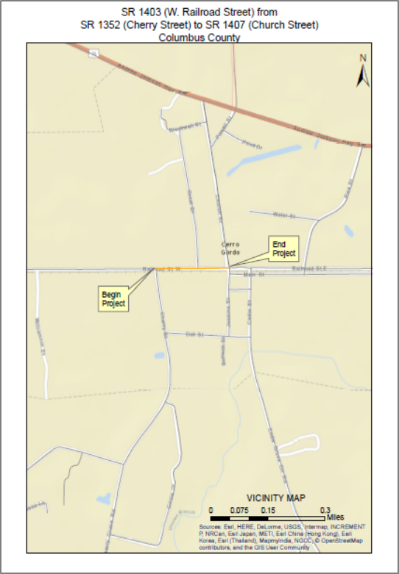
Mobility Fund – High Impact/Low Cost Projects
Project Cost: $25,000
Funding Year: FY 2018
Project Description:
Construct 2 ft symmetrical widening and resurface SR 1403 (W. Railroad Street) from SR 1352 (Cherry Street) to SR 1407 (Church Street) – [0.19 mi].

Slide 13
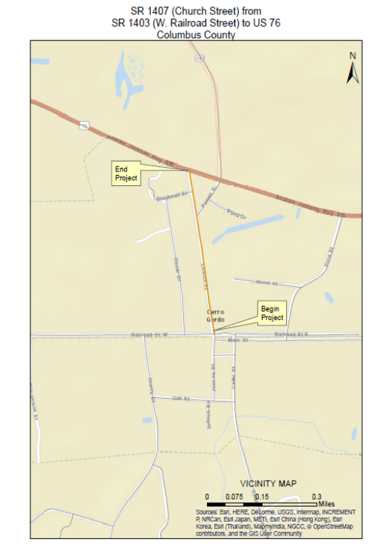
Mobility Fund – High Impact/Low Cost Projects
Project Cost: $50,000
Funding Year: FY 2019
Project Description:
Construct 2 ft symmetrical widening and resurface SR 1407 (Church Street) from SR 1403 (W. Railroad Street) to US 76 – [0.42 mi].

Slide 14
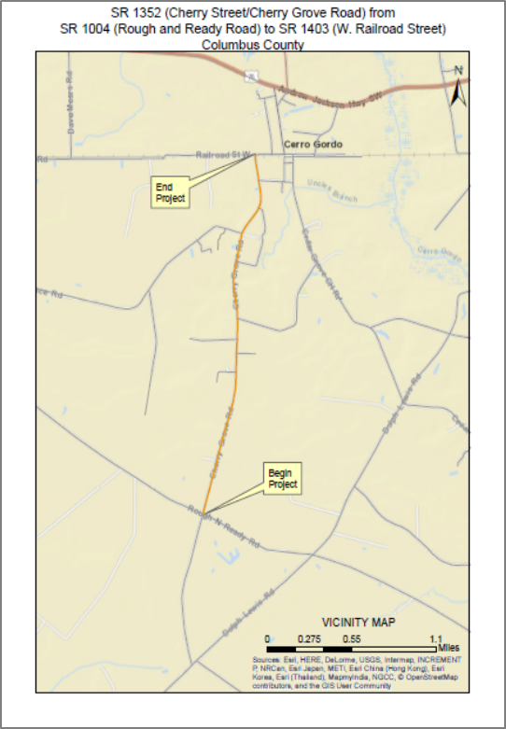
Mobility Fund – High Impact/Low Cost Projects
Project Cost: $250,000
Funding Year: FY 2019
Project Description:
Construct 2 ft symmetrical widening and resurface SR 1352 (Cherry Street/Cherry Grove Road) from SR 1004 (Rough and Ready Road) to SR 1403 (W. Railroad Street) – [2.29 mi].

Slide 15
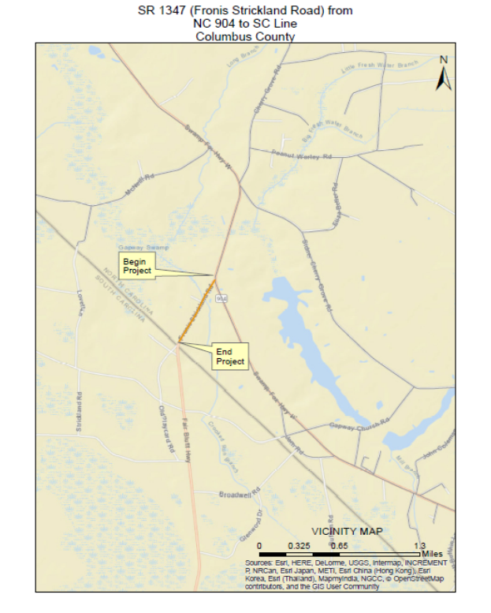
Mobility Fund – High Impact/Low Cost Projects
Project Cost: $75,000
Funding Year: FY 2019
Project Description:
Construct 2 ft symmetrical widening and resurface SR 1347 (Fronis Strickland Road) from NC 904 to SC State Line – [0.61 mi].

Slide 16
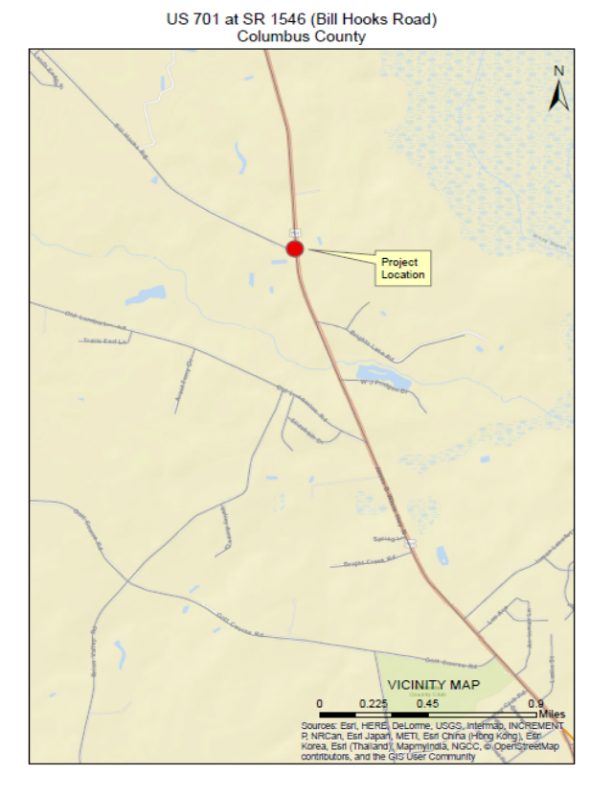
Mobility Fund – High Impact/Low Cost Projects
Project Cost: $300,000
Funding Year: FY 2019
Project Description:
Construct left turn lane on US 701 at SR 1546 (Bill Hooks Road).

Slide 17
Mobility Fund – High Impact/Low Cost Projects
High Impact Low Cost Projects
Next Steps – Division 6
All projects have been added to the Board of Transportation agenda and were presented for approval at the February Meeting.
For projects exceeding $250K, District Engineers have sent Resolutions of support to local governments for approval. Most resolutions are on local board agendas for January/February meetings.
District Engineers will begin including High Impact/Low Cost projects in the next round of resurfacing projects (Spring 2018).

Slide 18
Mobility Fund – High Impact/Low Cost Projects
High Impact Low Cost Projects
Next Steps – NCDOT Management
After all projects statewide have been approved by the Board of Transportation, NCDOT Management is required to submit a report to the Joint Legislative Transportation Oversight Committee by March 1, 2018.
The report will include the types of projects submitted, funding amounts, criteria selection process, criteria used and project scoring methodology for each Division.
The goal is to demonstrate there is a need to make High Impact Low Cost Construction a permanent funding source.
Notes:
Report to JLTOC to be presented by Patrick Norman – Director of Highway Operations

Slide 19
Mobility Fund – High Impact/Low Cost Projects
Questions ??

Slide 20
Mobility Fund – High Impact/Low Cost Projects
High Impact Low Cost Projects
Contact Information:
Darius Sturdivant
Division 6 Planning Engineer
Email: ddsturdivant@ncdot.gov
Phone: (910) 364-0600

